Slide 1
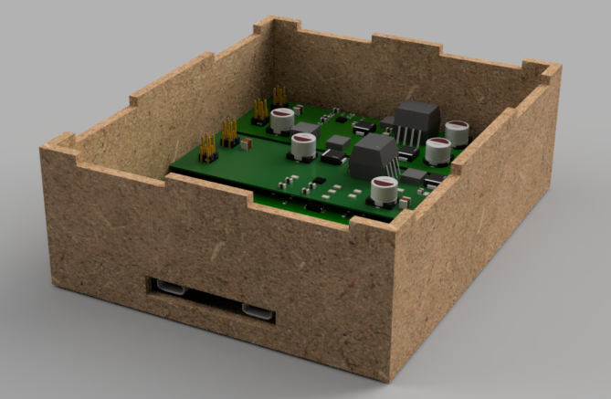
USB-C Isolator – Winter Final Presentation – Group 9 April 6th 2023
David Zhou – Data
Praise Ebirim – Systems
Robert Boucher – Power
Nick Cardamone – Data/ Systems
Daniel Oluwayomi - Power

Slide 2
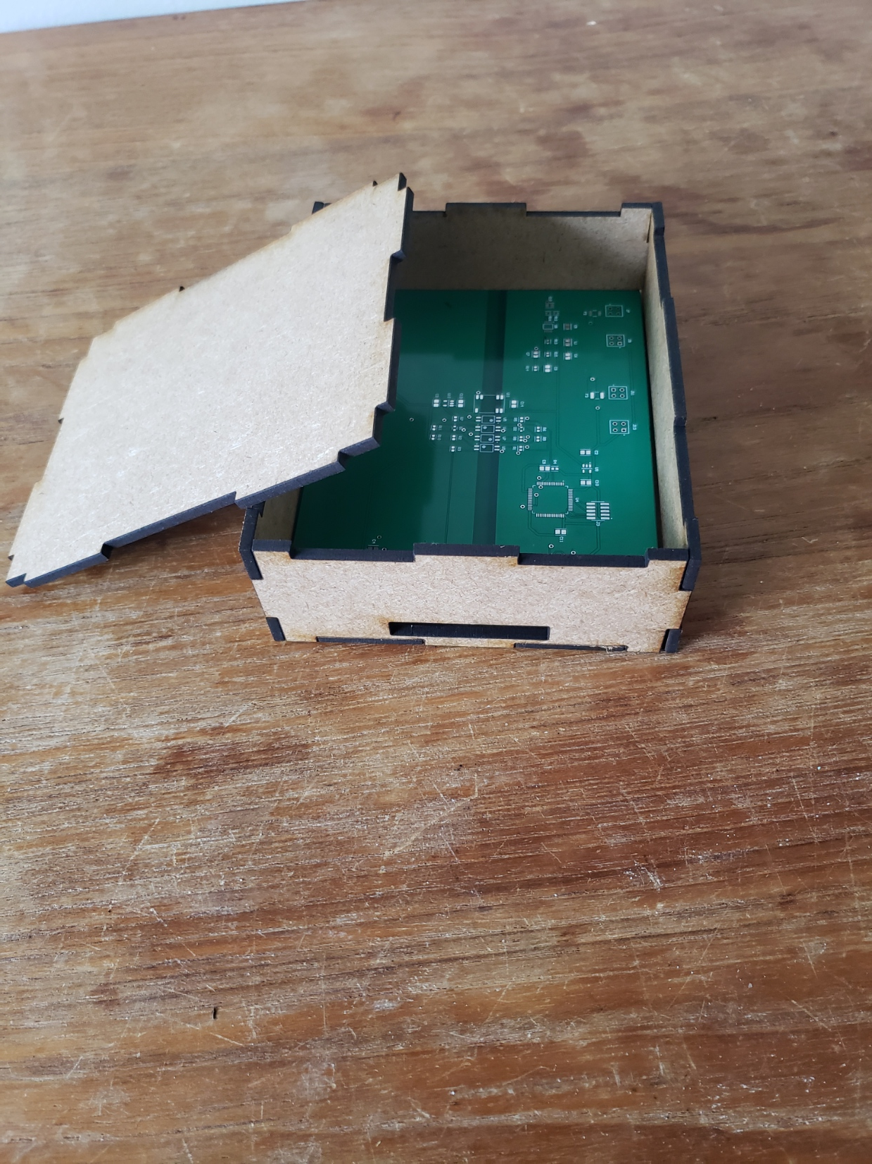
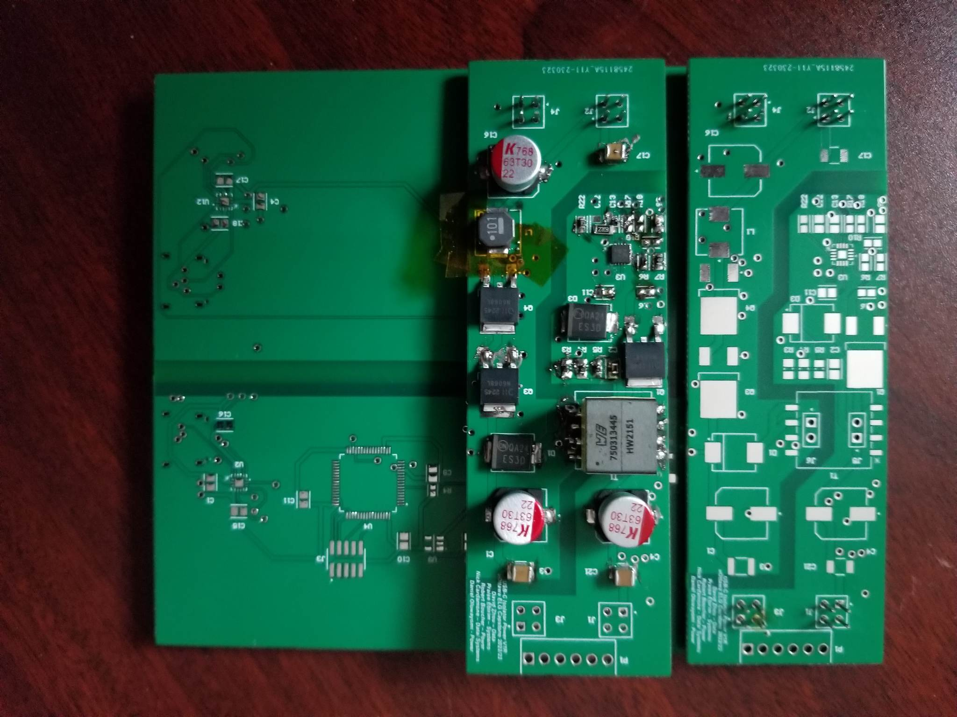
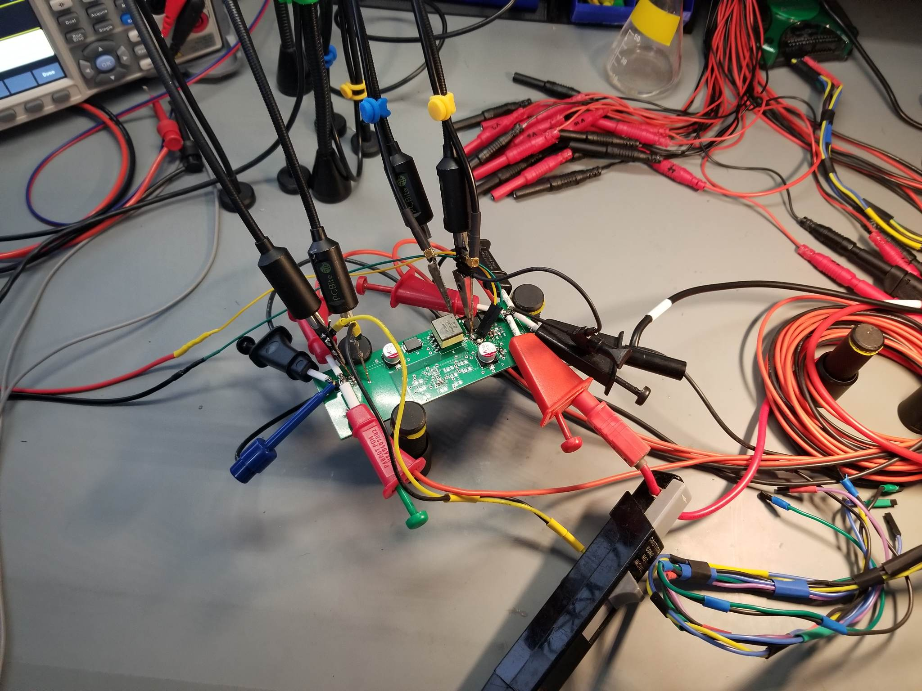
Overview (Daniel)
Short Demo + Introduction
Project Overview/ Reminder
Use Cases + Target Specs
Design Explanation/ Overview
Assembly
BOM/ Funding
Improvements
Discussion
Questions
Notes:
Daniel

Slide 3
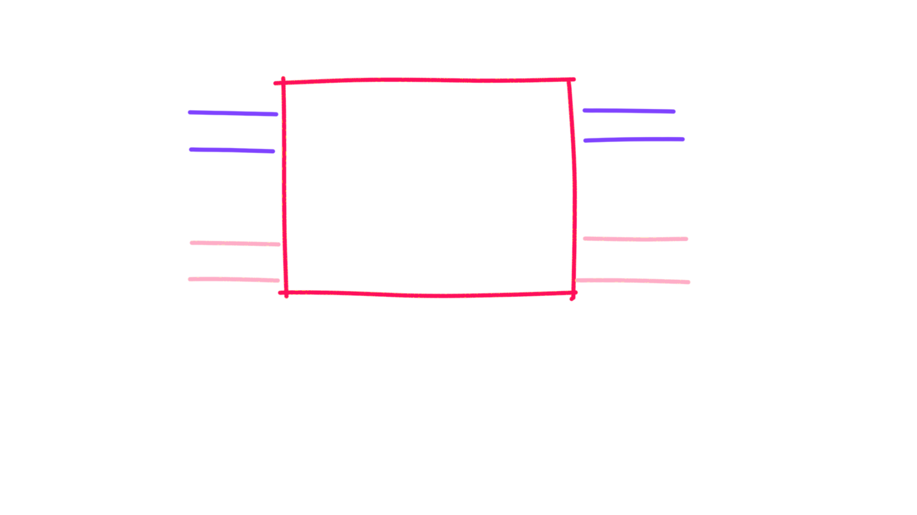
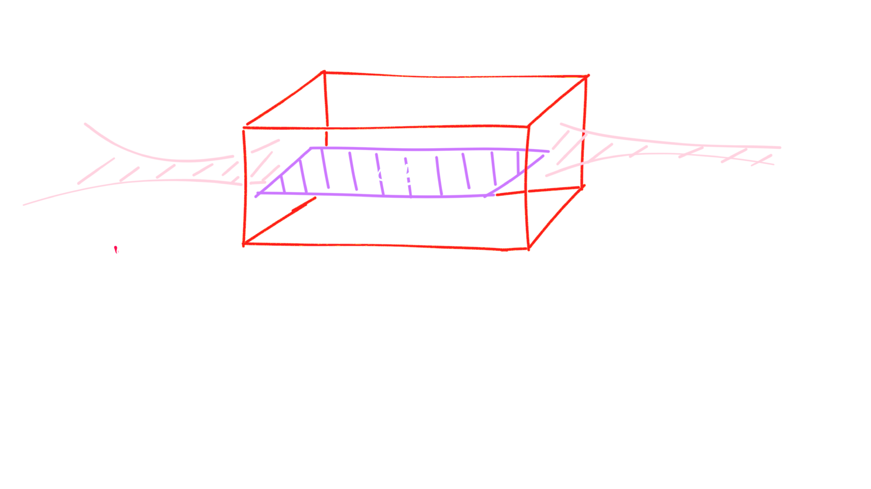
Introduction
MVP: Single channel USB-C Isolator (Data and Power)
Full Product: Multichannel USB-C Isolation Hub with Data Logging Features
Note*: Only MVP is drawn/ discussed in this presentation

Slide 4
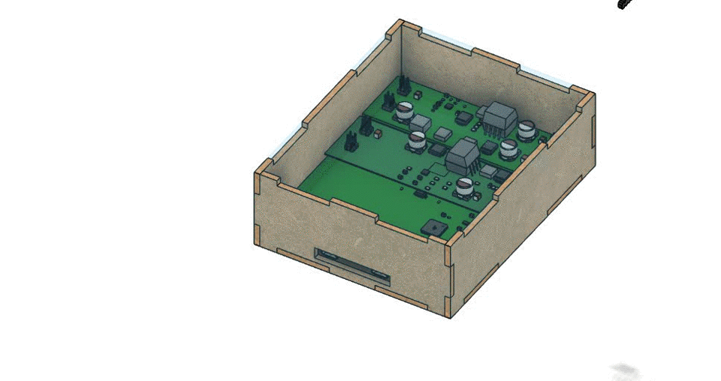
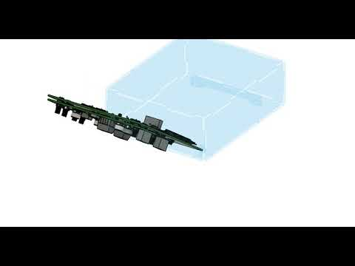
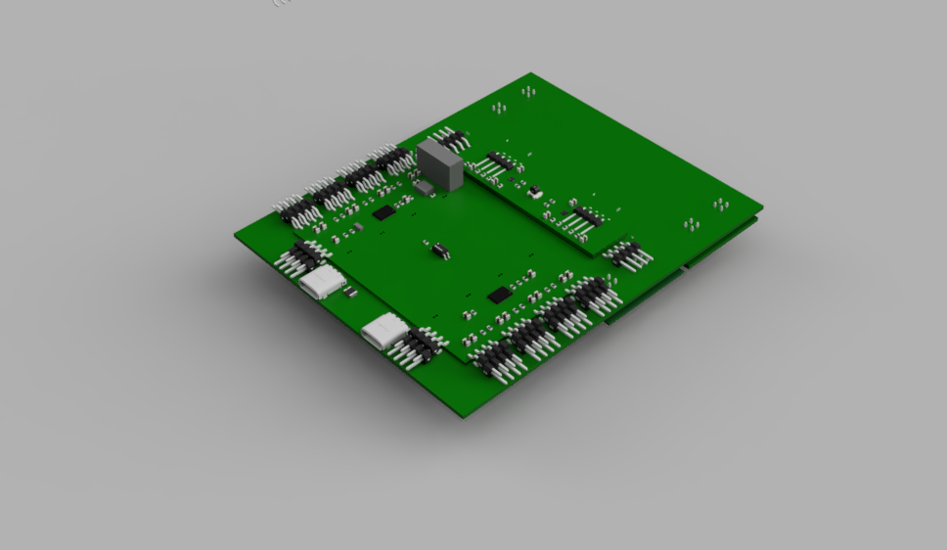
Design Overview
Each subsystem gets it’s own daughterboard
Daughterboards are soldered onto main systems PCB (Castellations on daughter boards)
PCBs are 4 layers
Top and bottom are signal and inner layers are power and ground planes

Slide 5
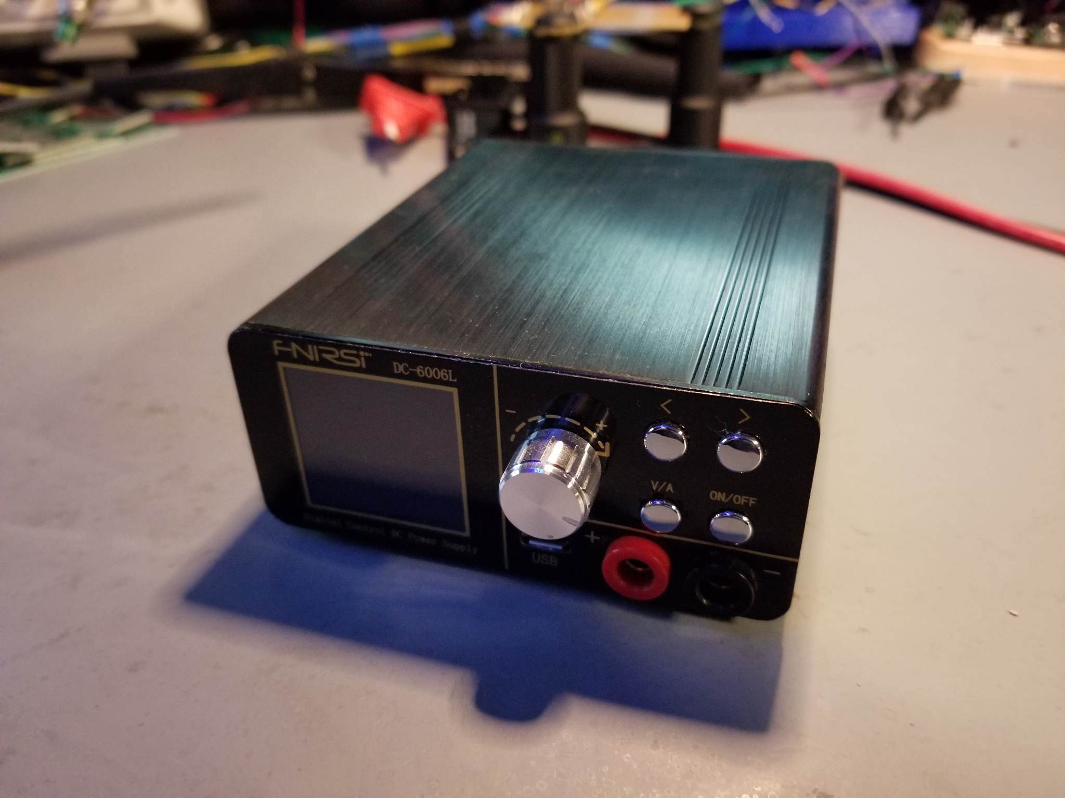
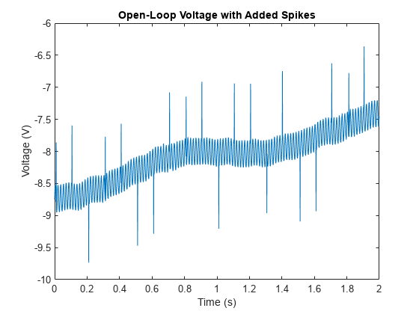
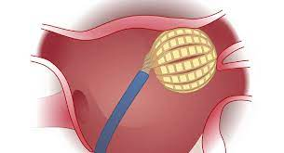
Use Cases
Commonly used in/with USB
Medical Equipment
Sensitive Industrial Equipment
Scientific Equipment
Audio Equipment
Protects signals from
Noise
Voltage Spikes
Surges
Ground loops
USB-C Power Supply
Globe Pulsed field mapping and ablation System

Slide 6
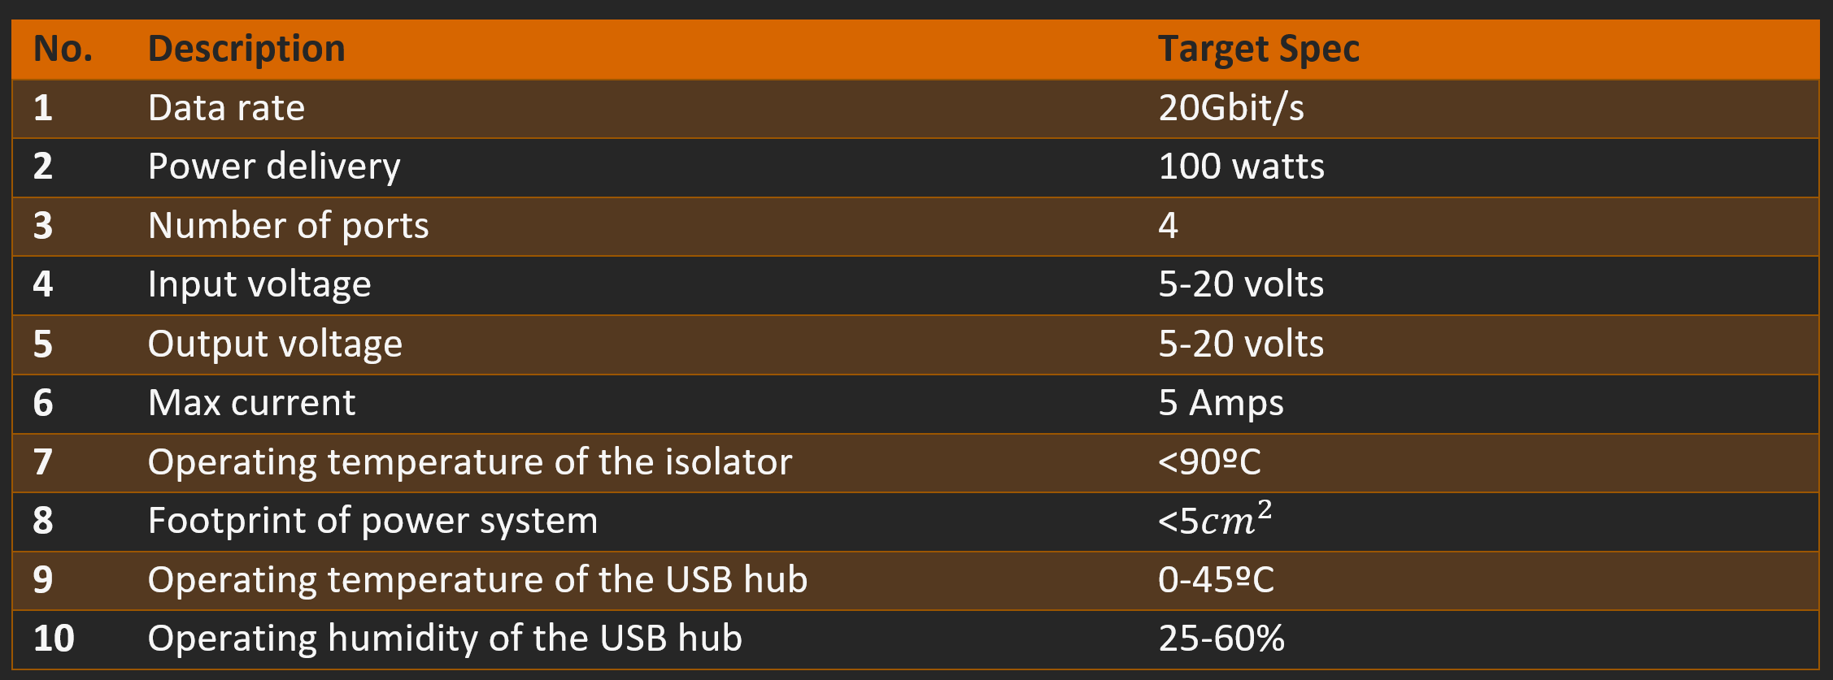
Target Specs
2

Slide 7
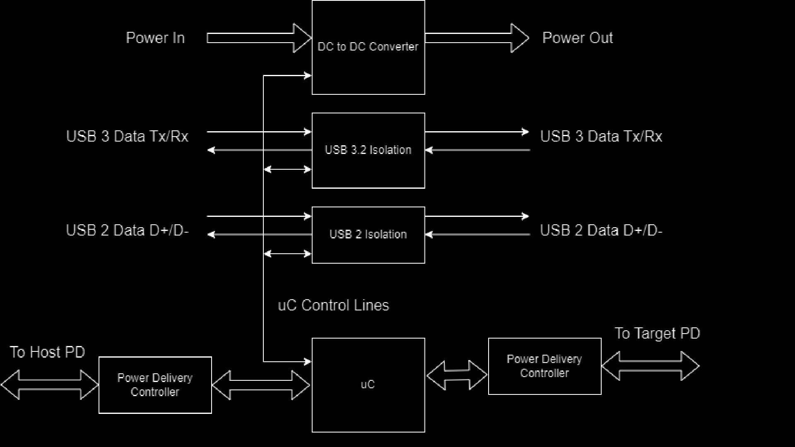
Design Overview

Slide 8
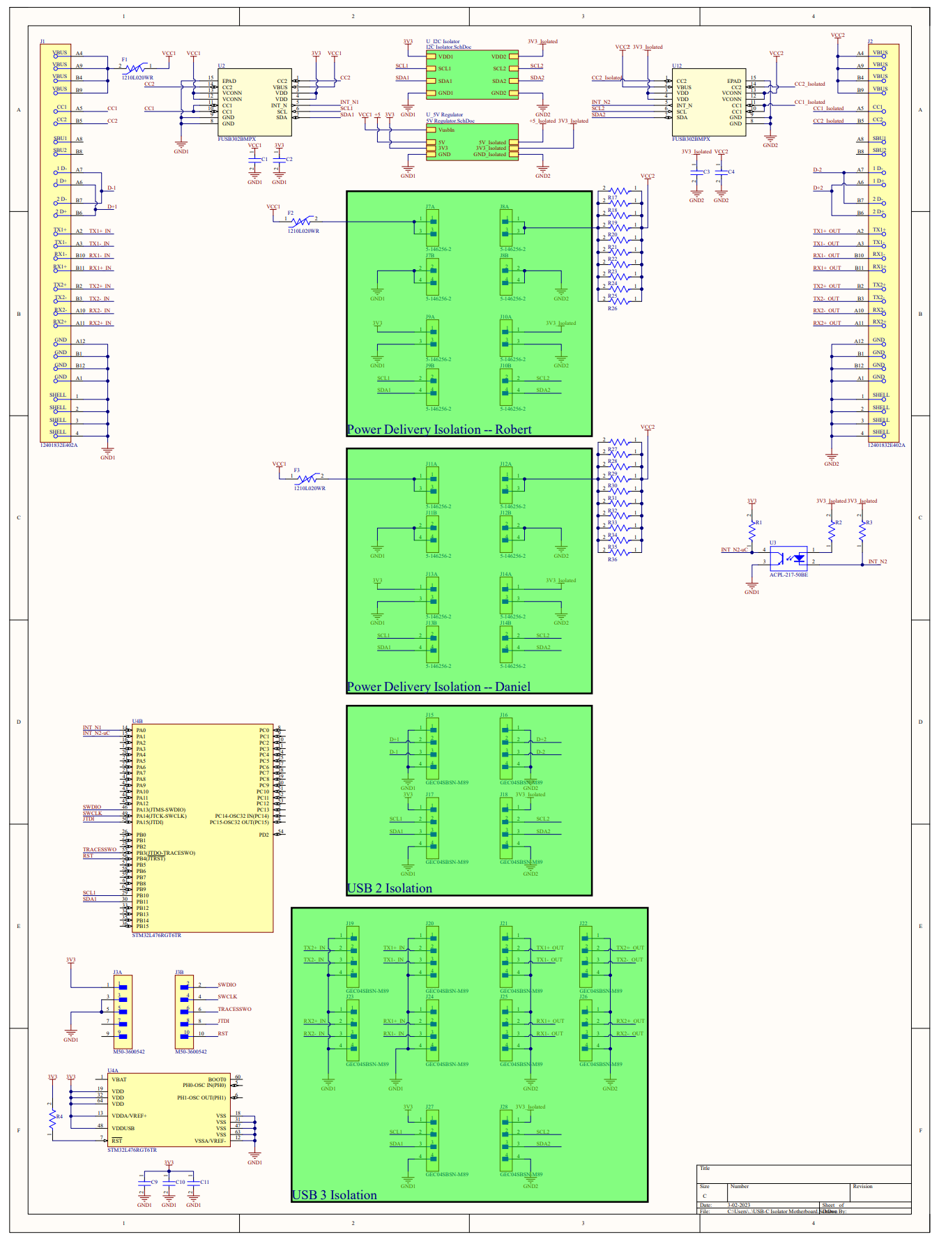
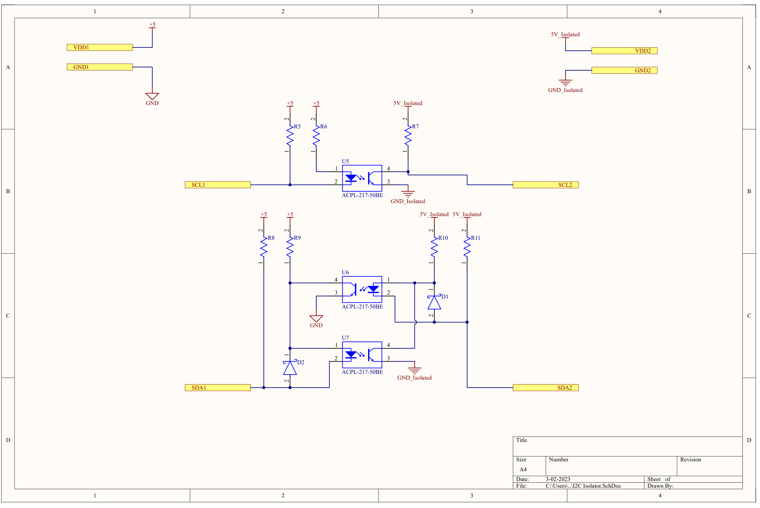
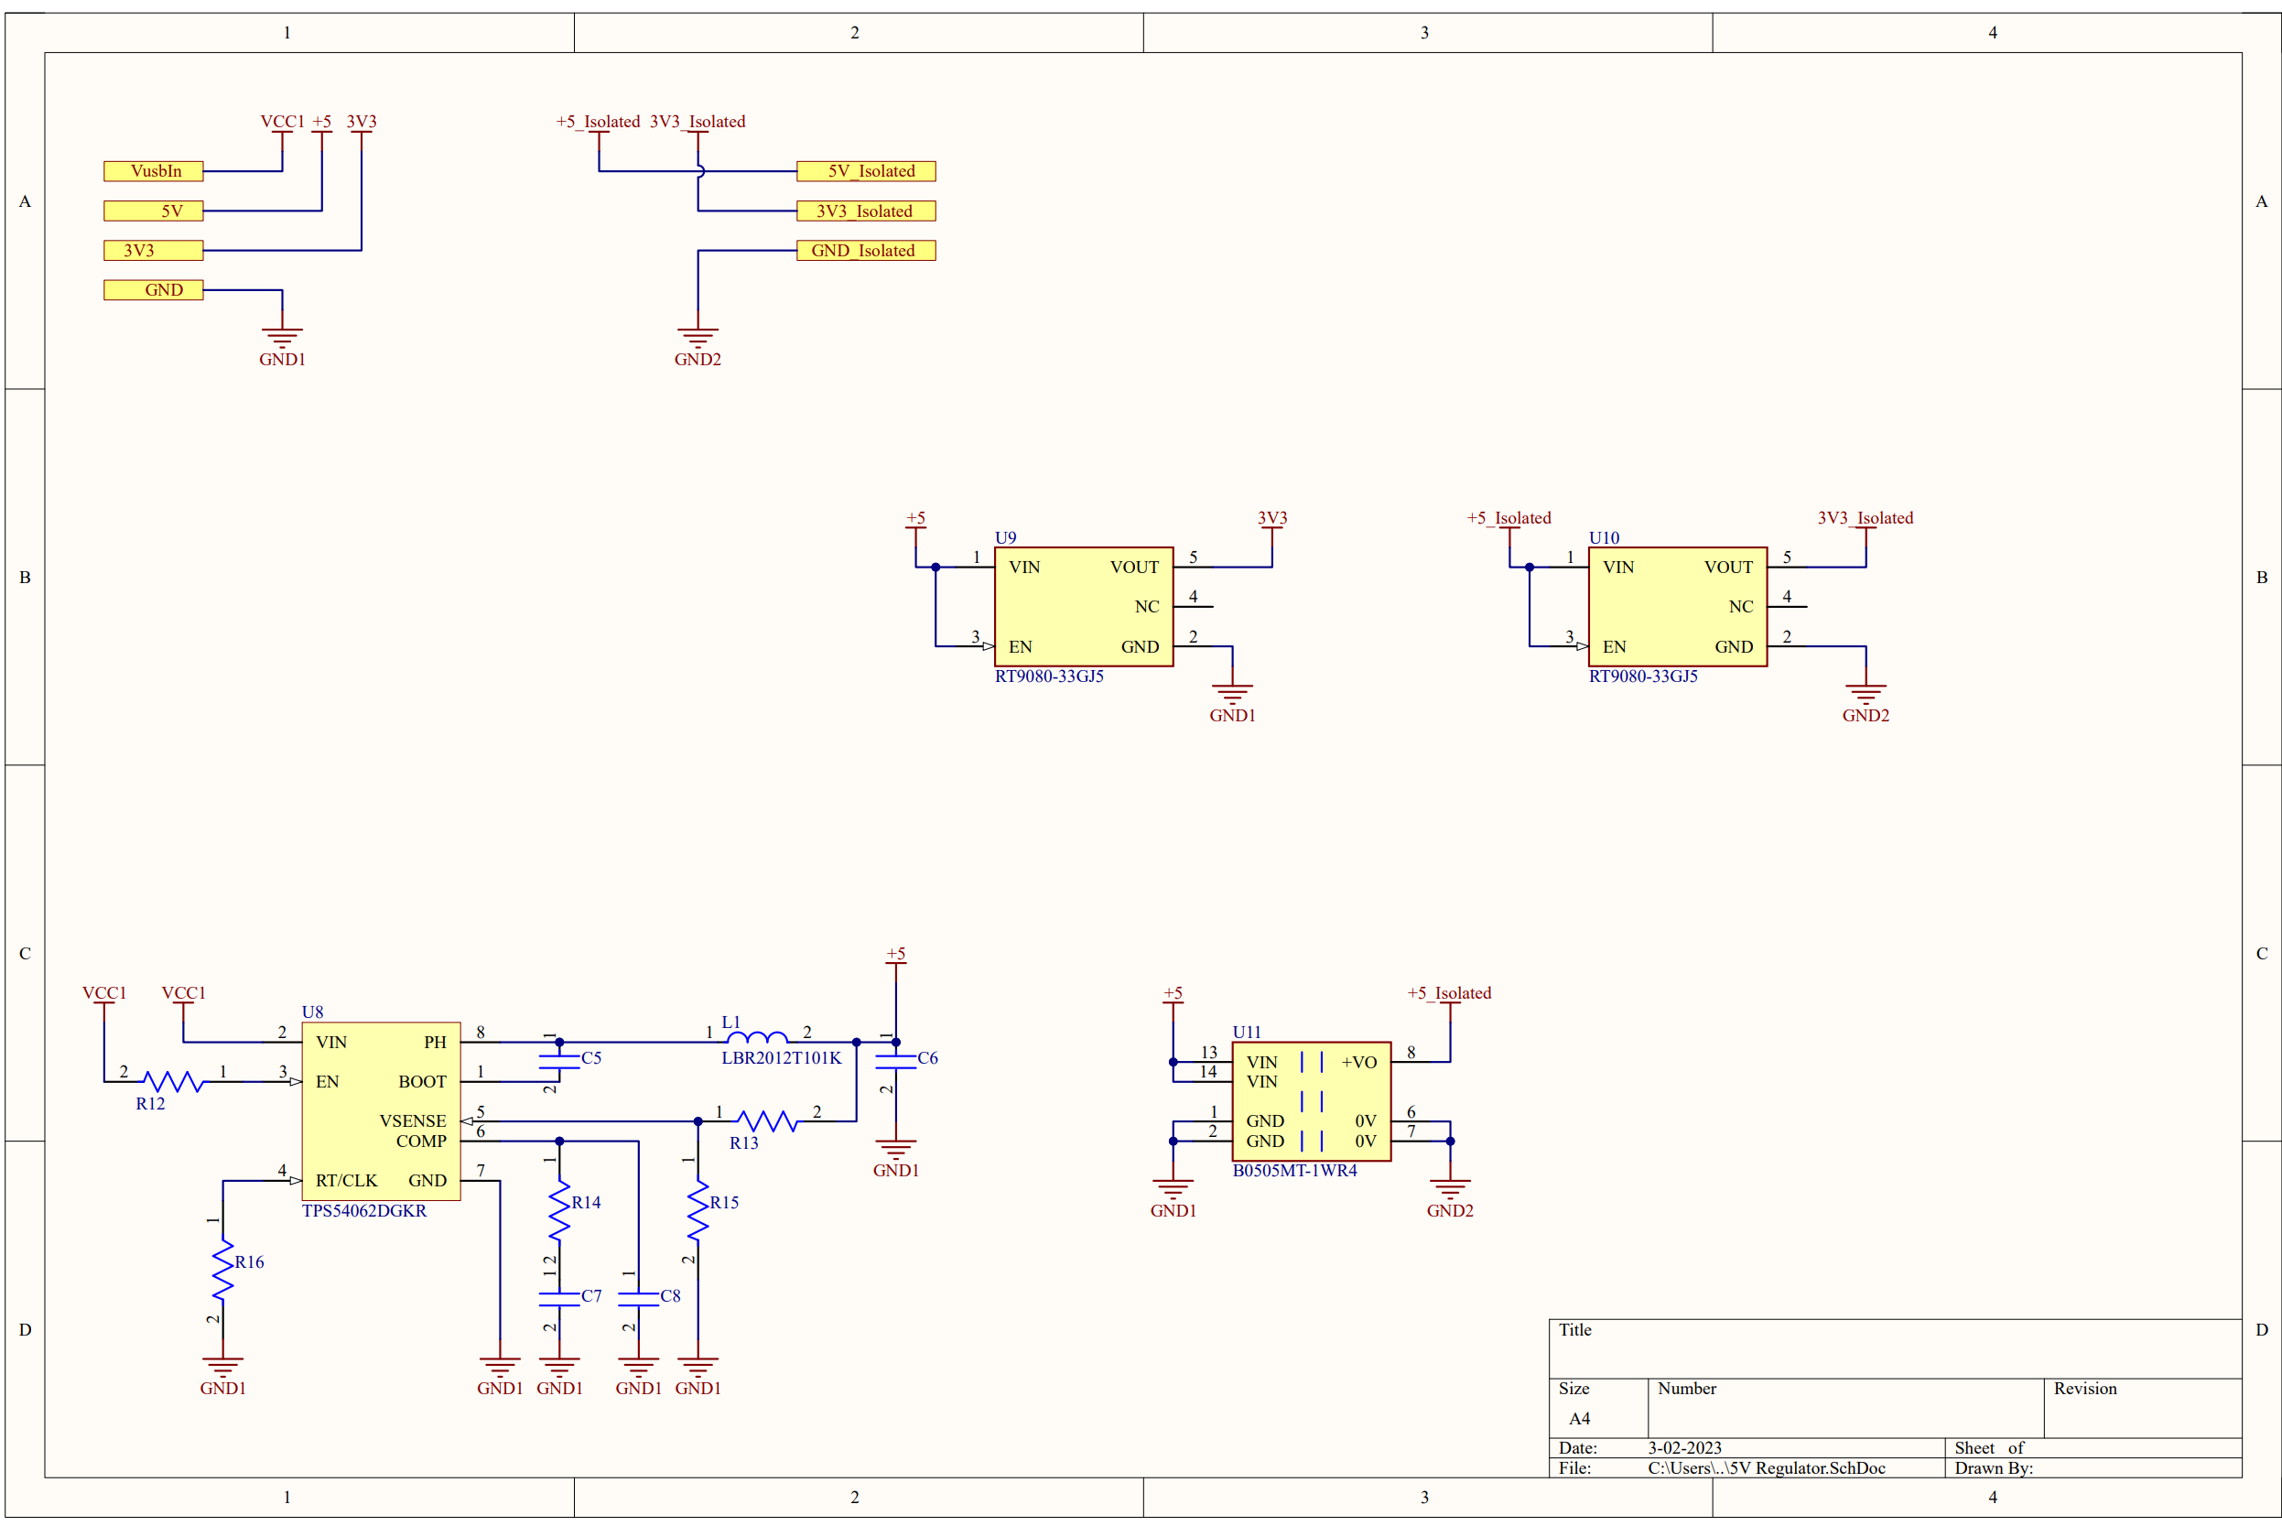
Systems Design
Main motherboard with daughter boards
STM32 to control everything

Slide 9
More Systems Design
I²C Isolation done by optocouplers

Slide 10
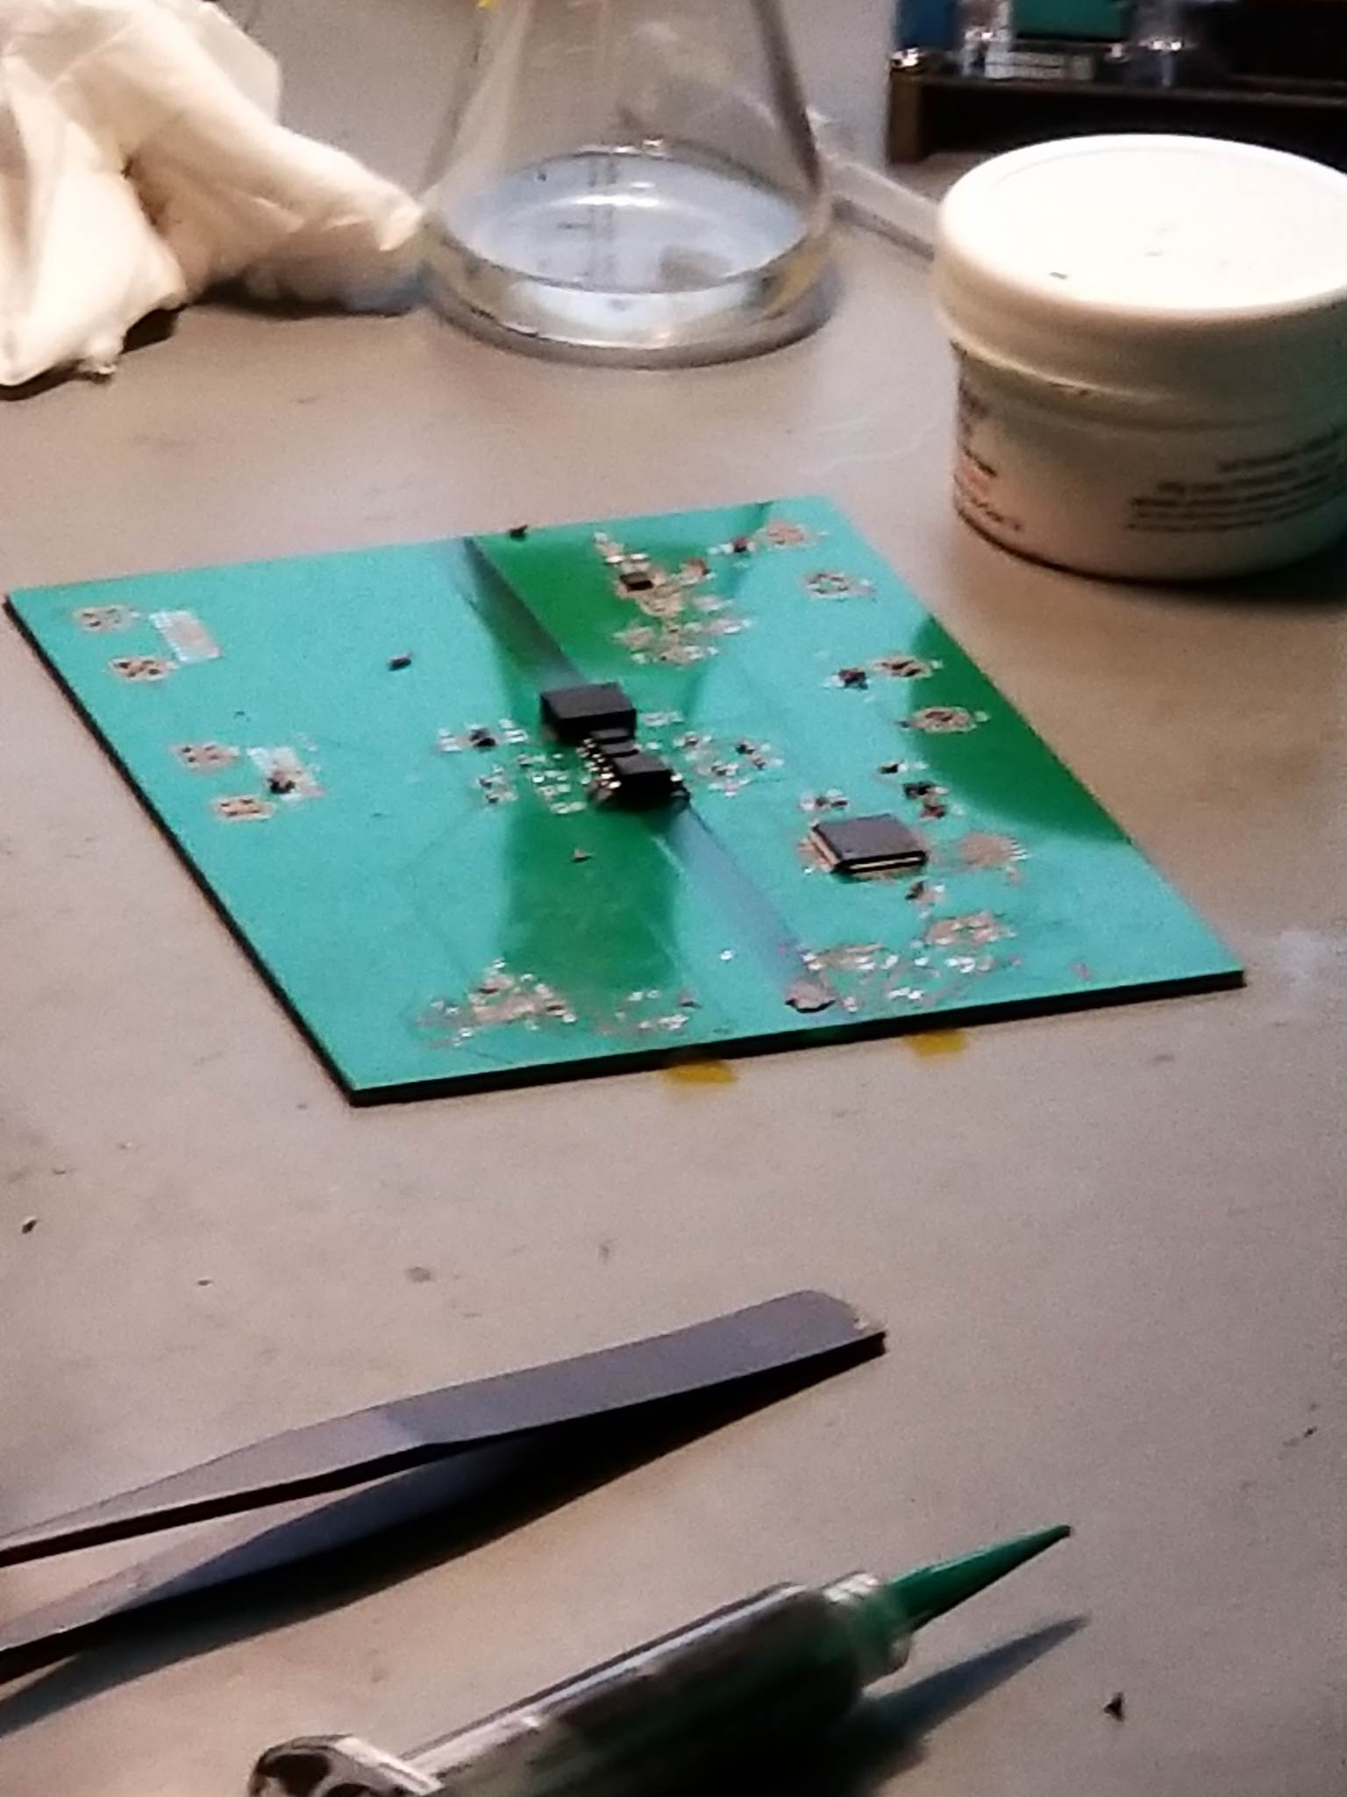
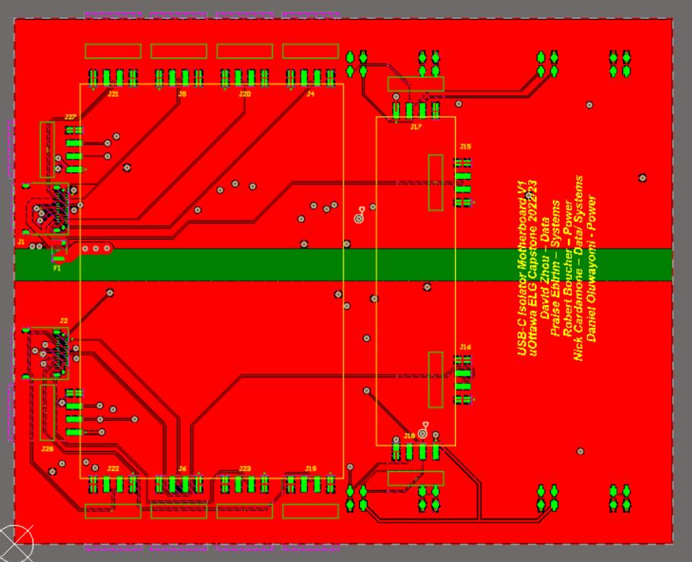
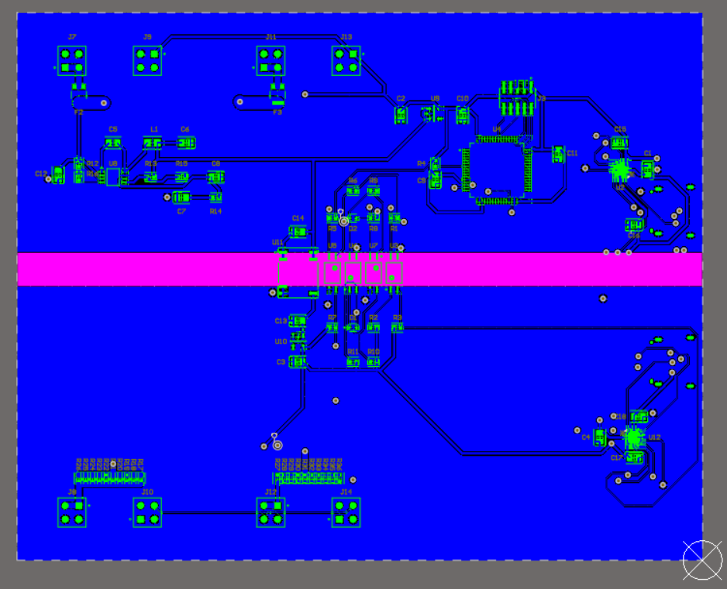
Motherboard PCB
4 layers
Daughter boards mount with headers

Slide 11
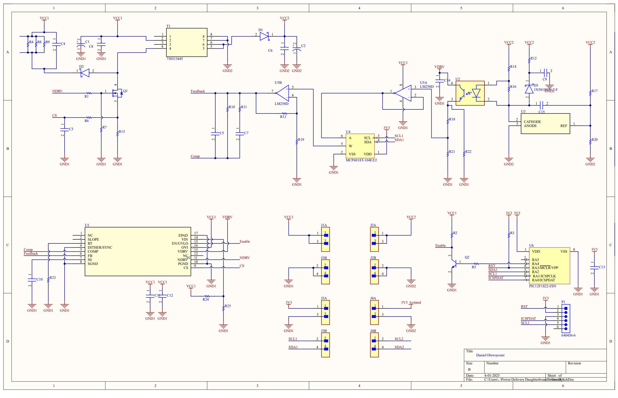
Power Isolation
Transformer
Output Rectifier
V Sense
Switching FET
Loop Compensation
E-Pot
DC to DC Controller
PIC Enable Controller

Slide 12
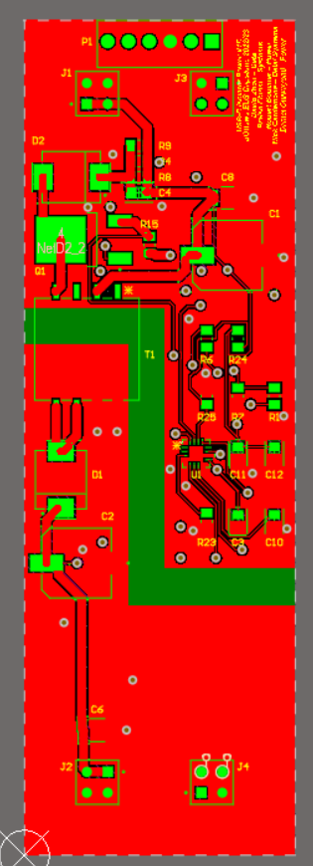
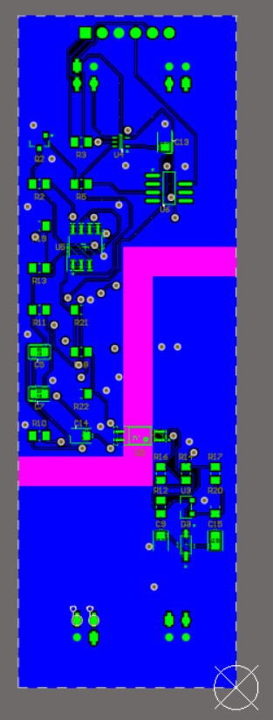
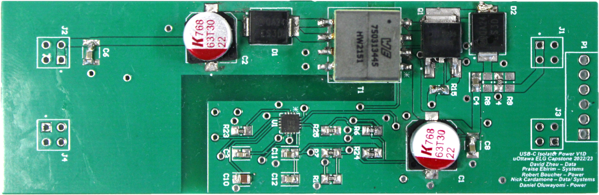
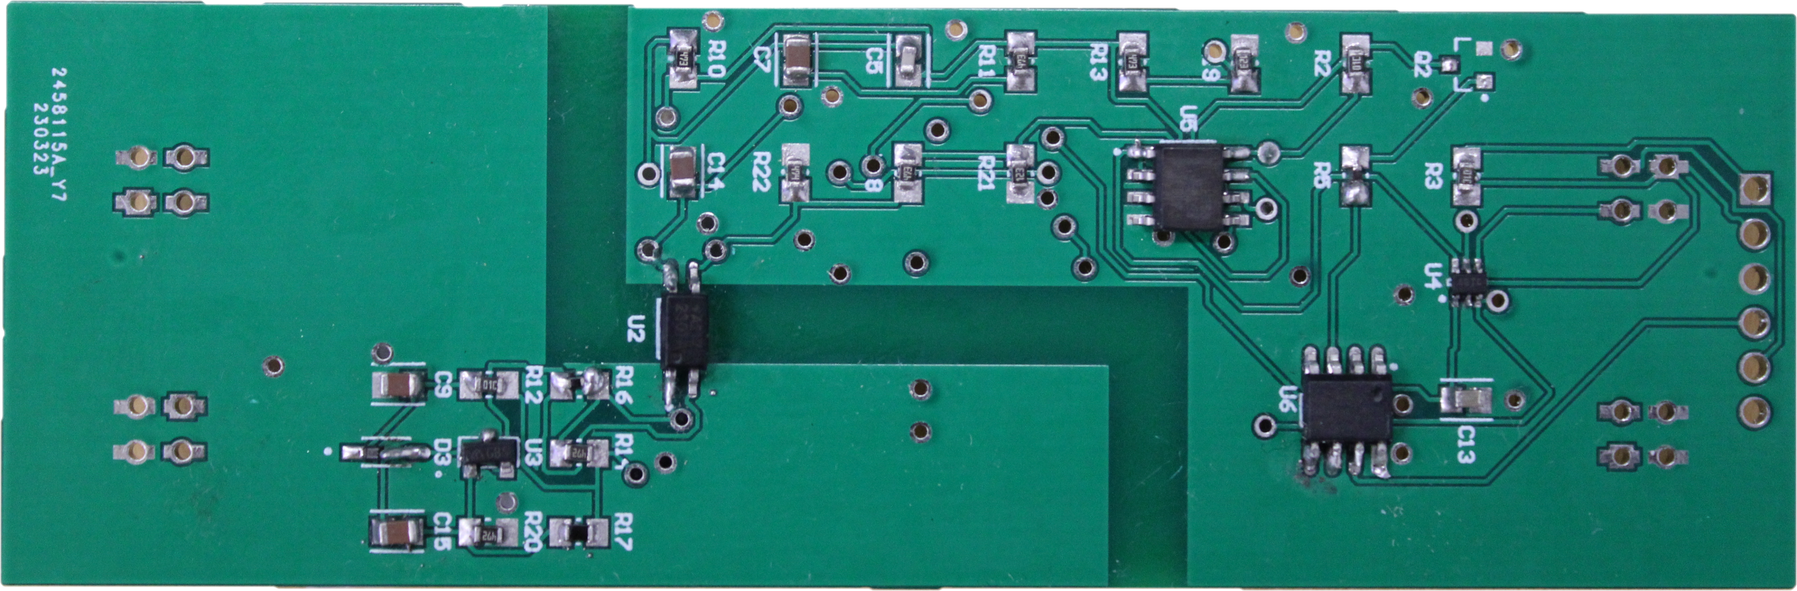
Power PCB Version A

Slide 13
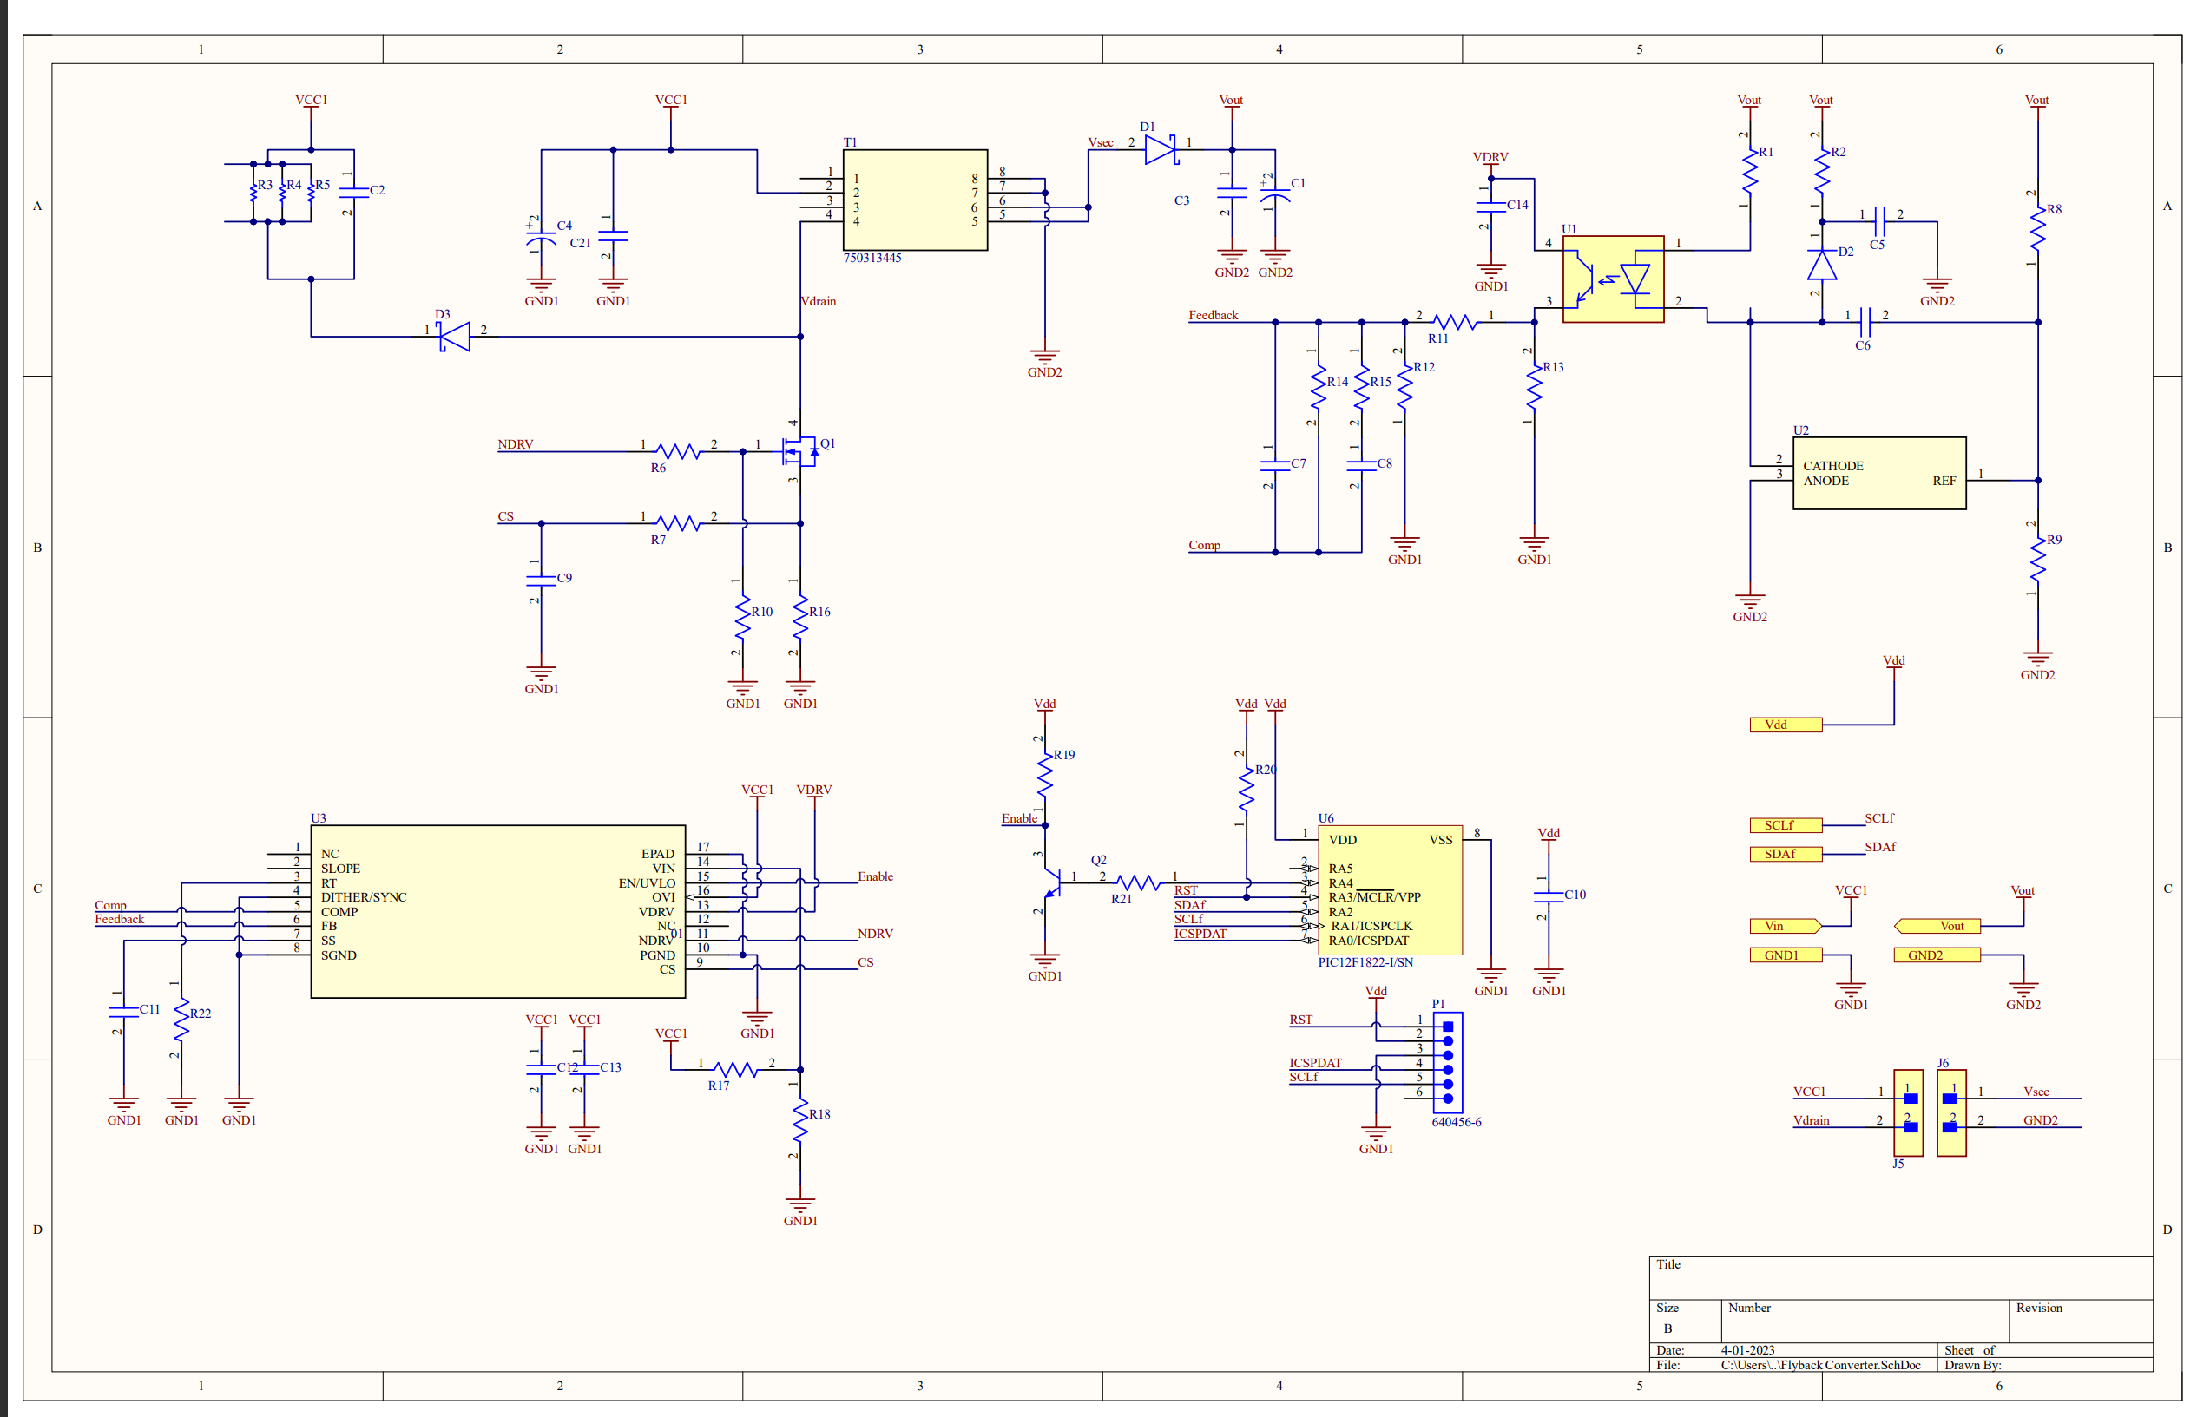
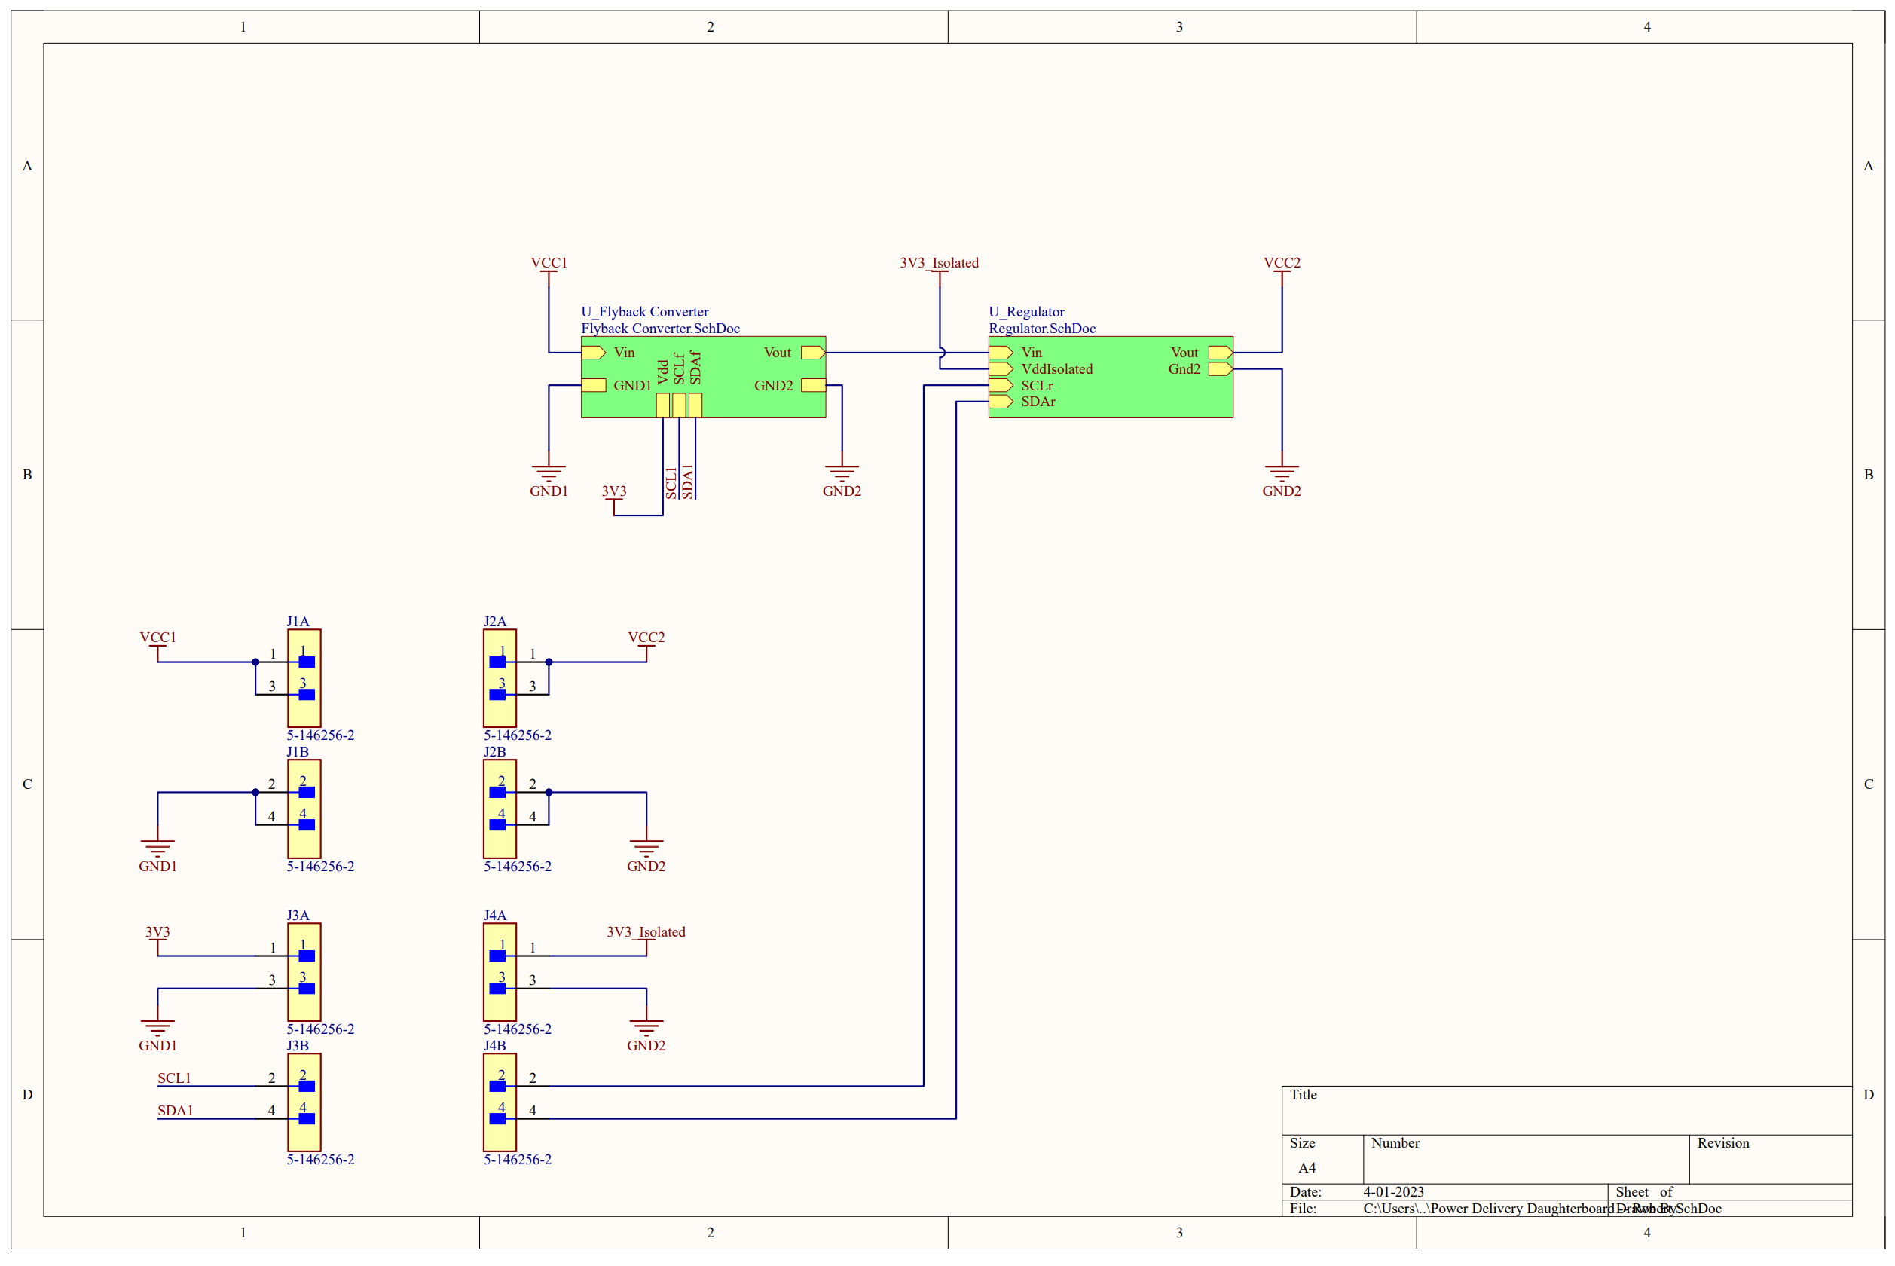
Power Isolation Version A

Slide 14
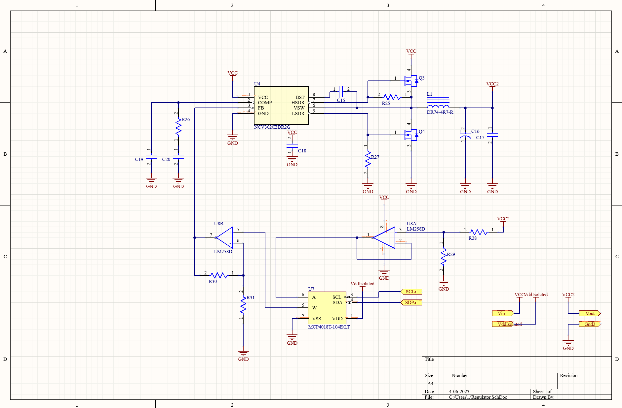
Power Isolation Version A

Slide 15
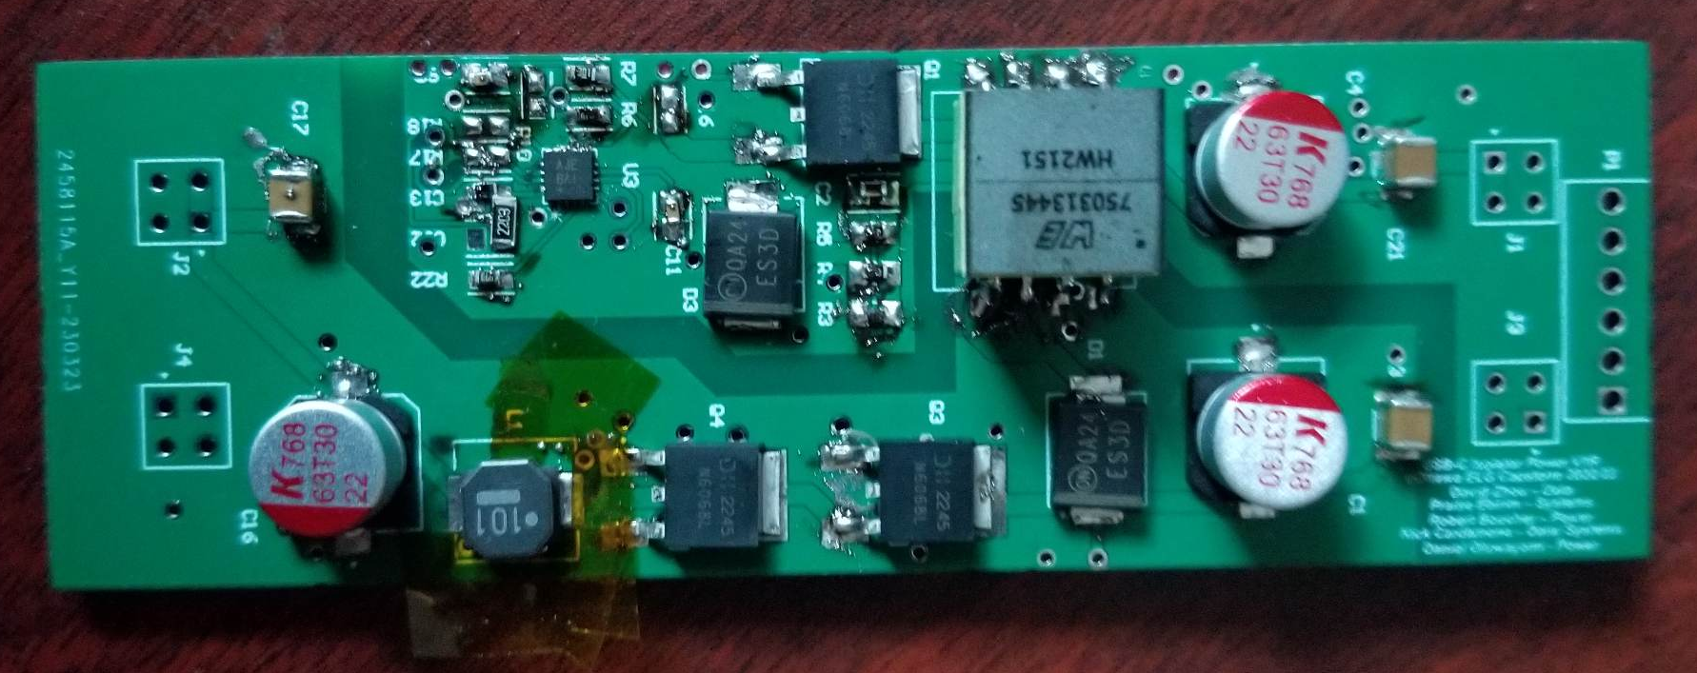
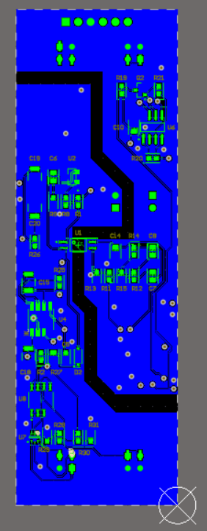
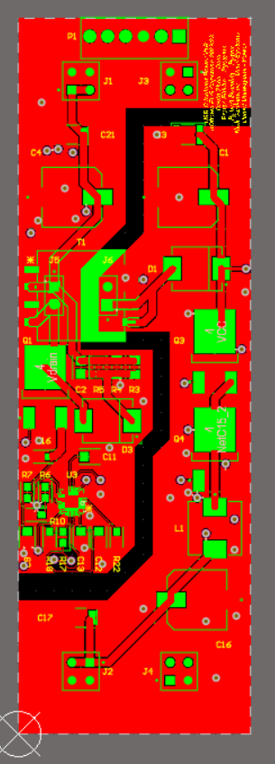
Power PCB Version A

Slide 16
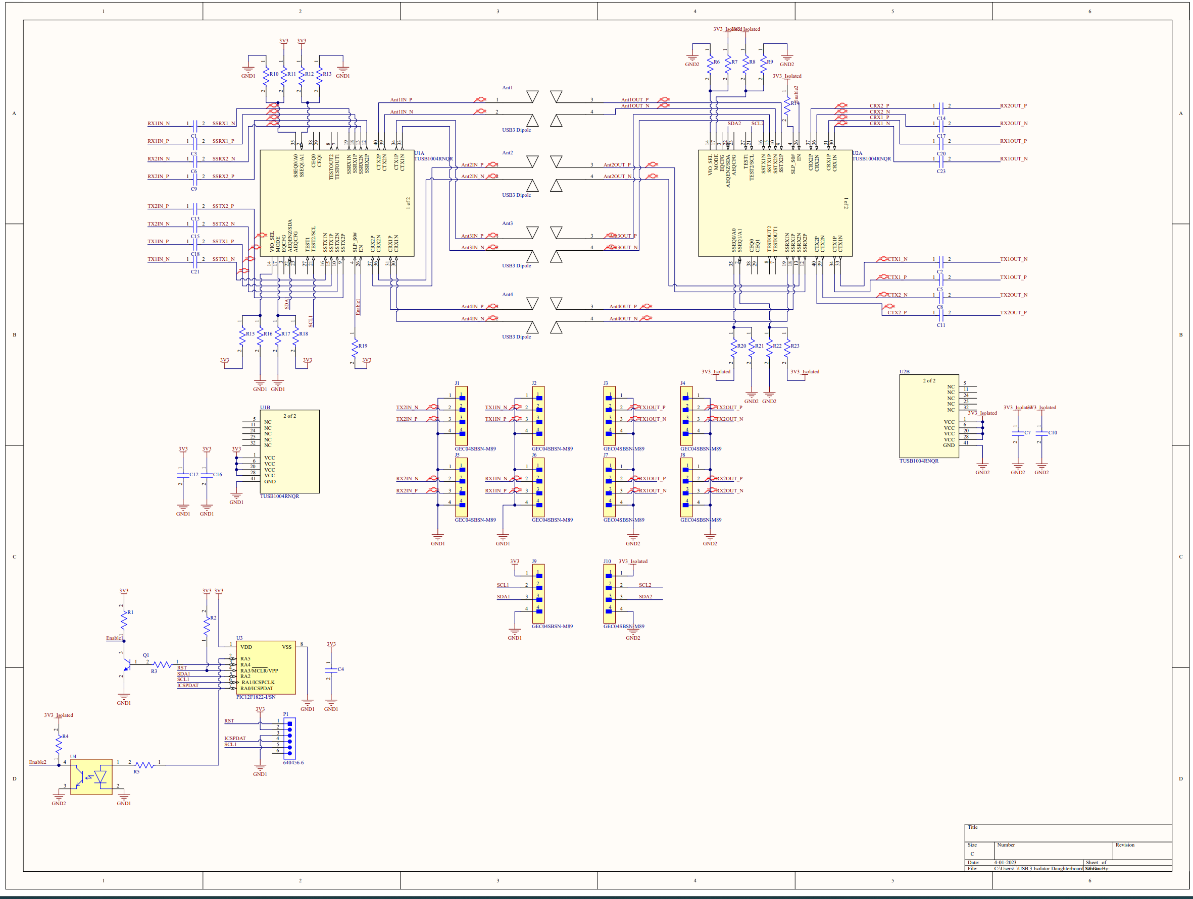
USB 3

Slide 17
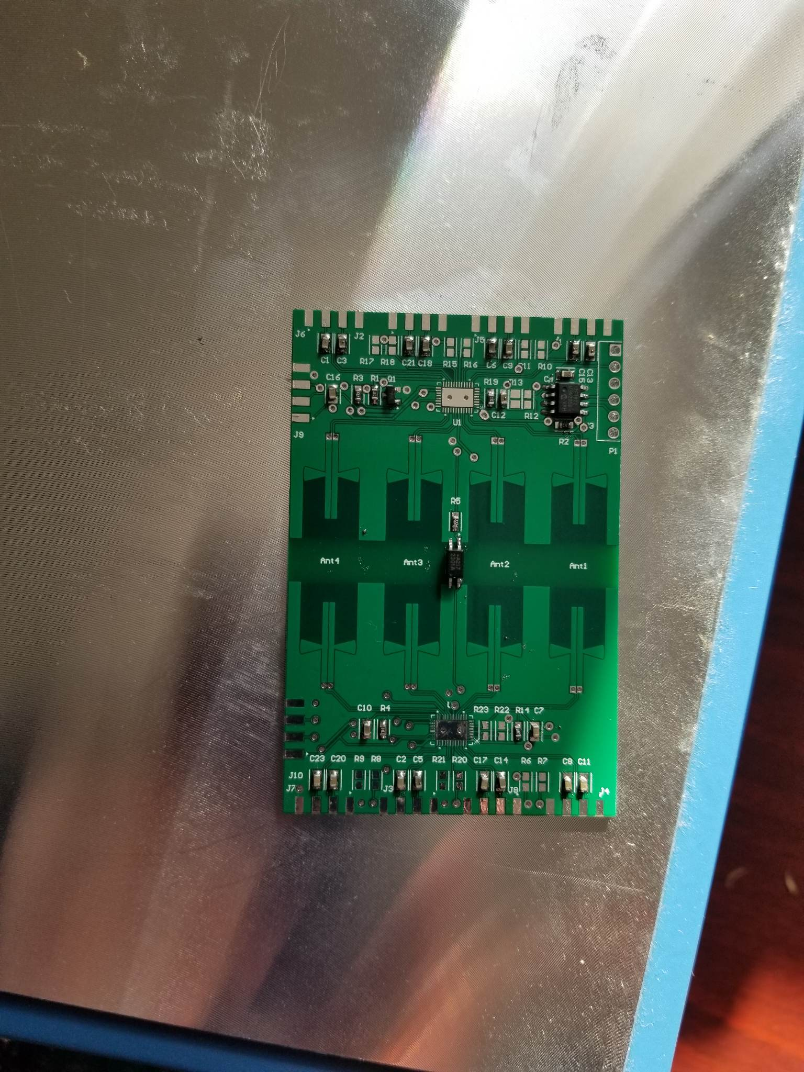
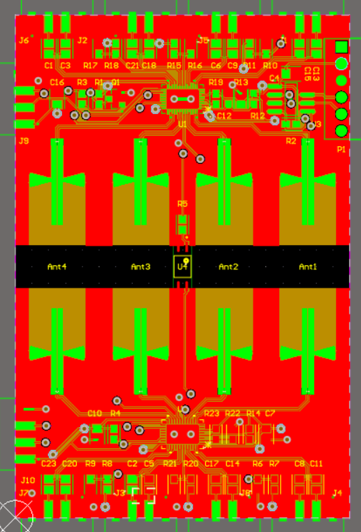
USB 3 PCB

Slide 18
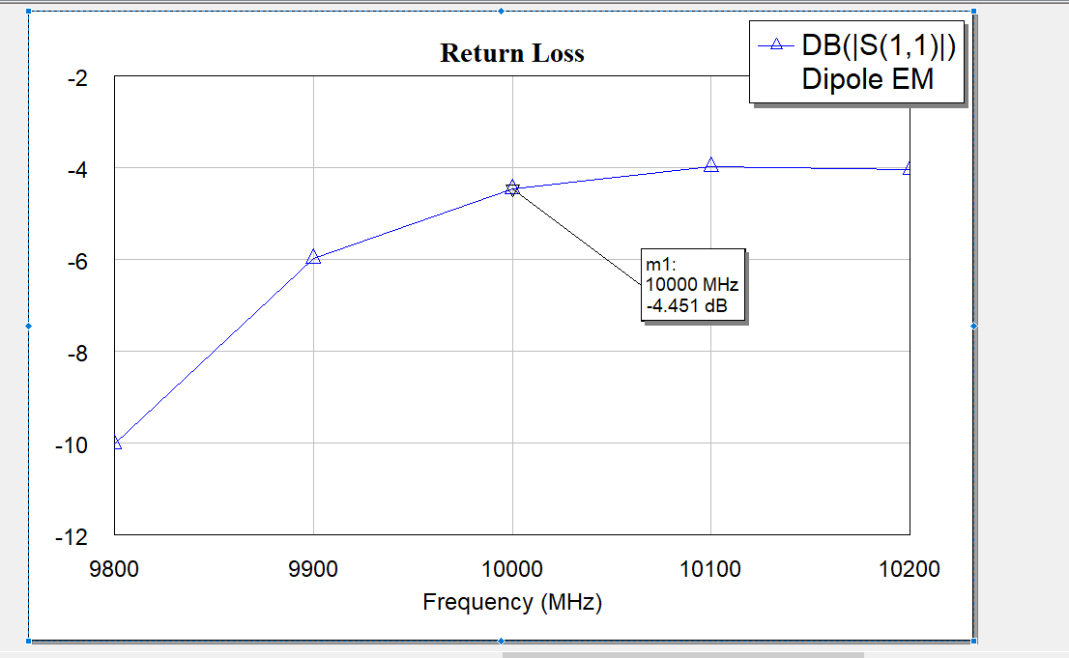
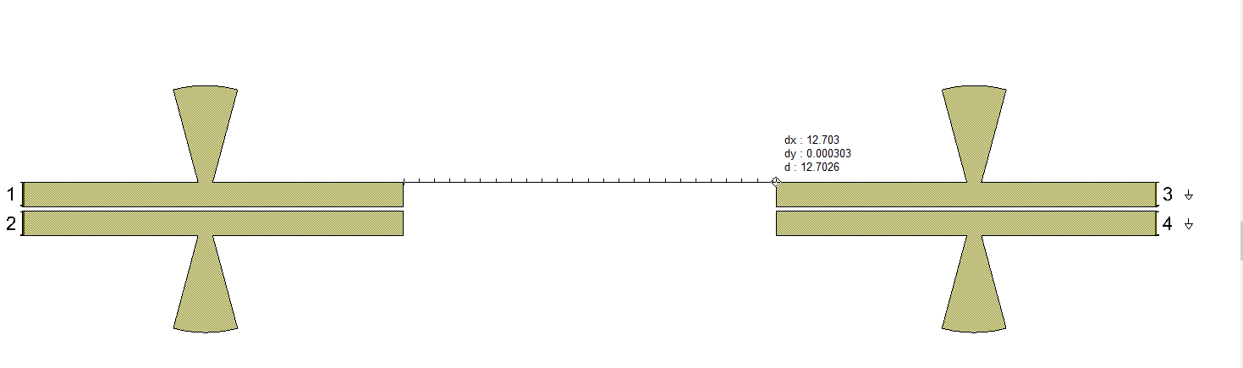
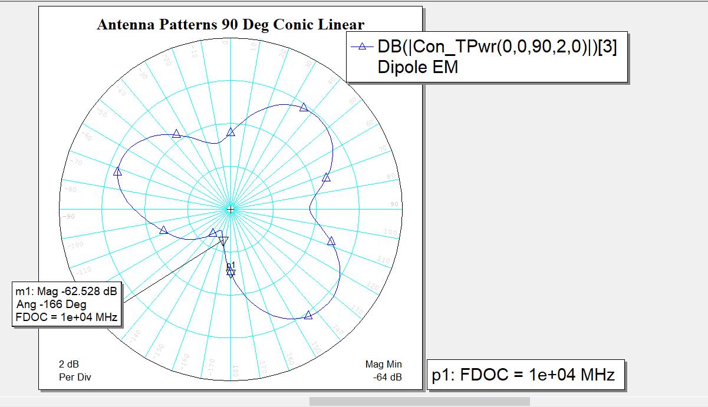
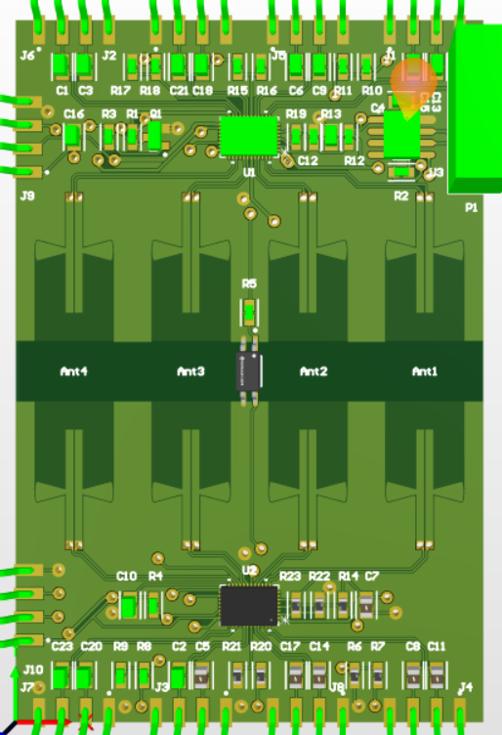
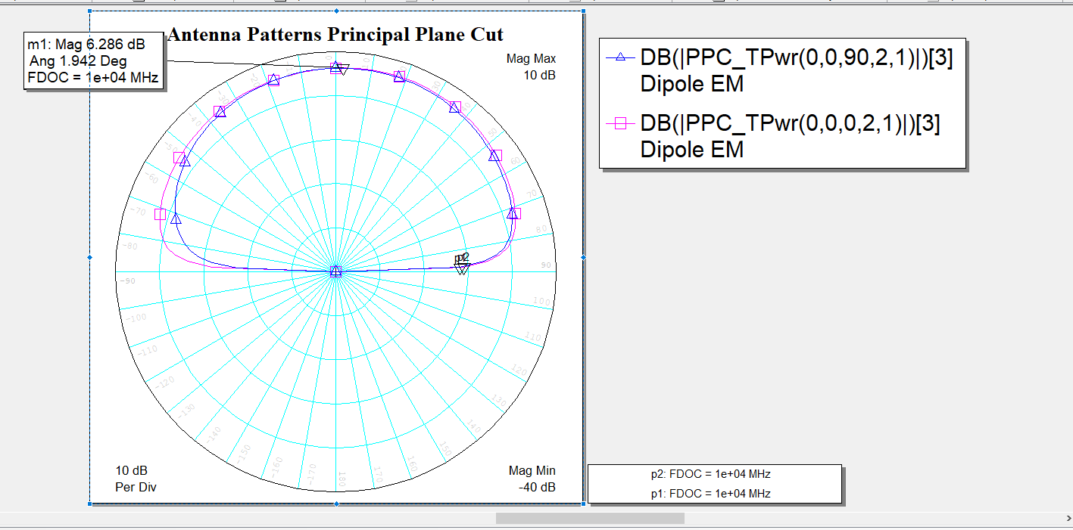
USB 3 Antenna Design

Slide 19
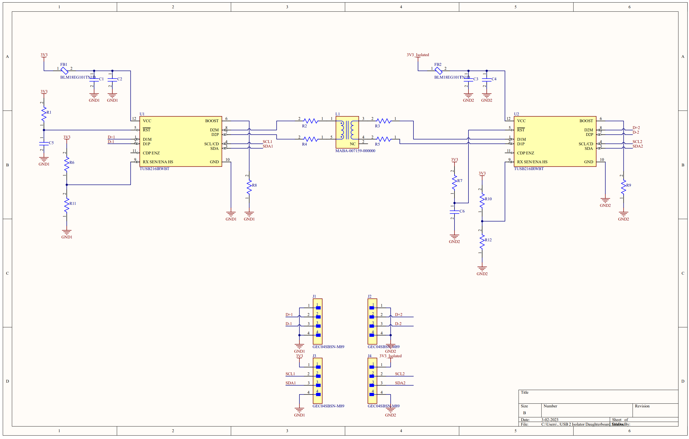
USB 2

Slide 20
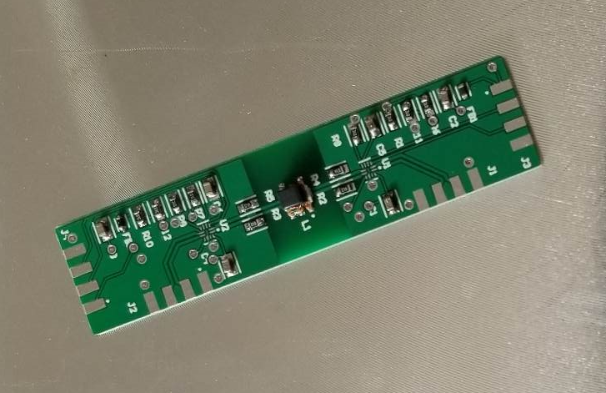
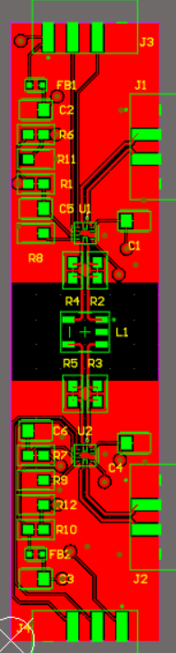
USB 2 PCB

Slide 21

Systems/ Firmware
uC: STM32

Slide 22
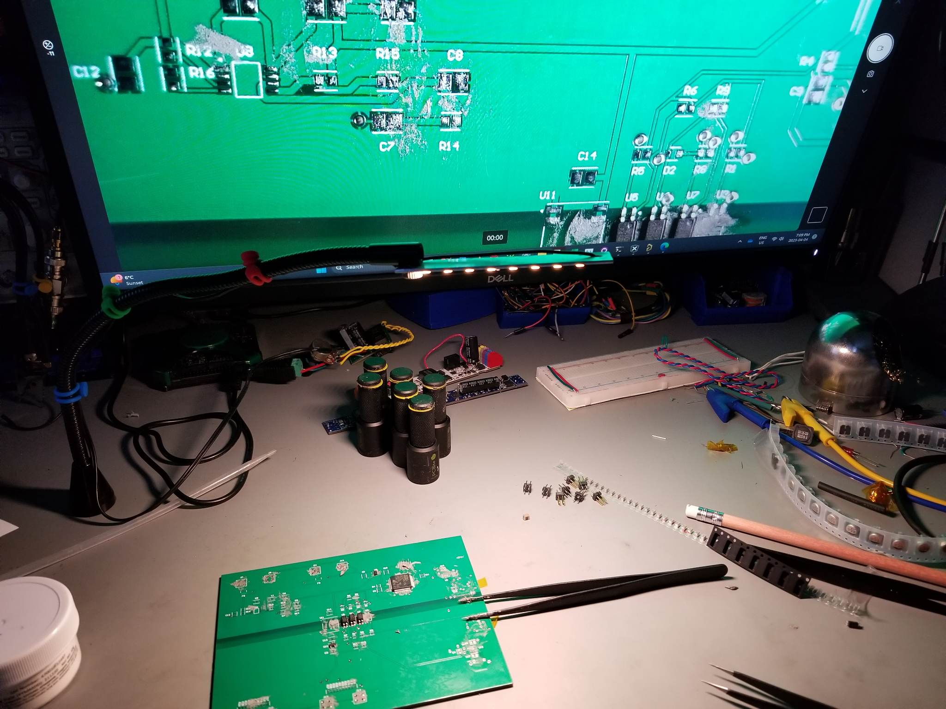
Assembly

Slide 23
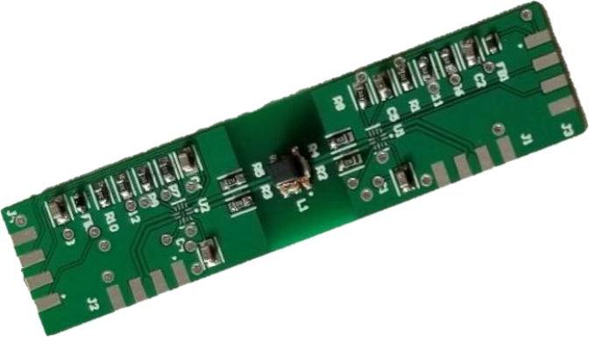
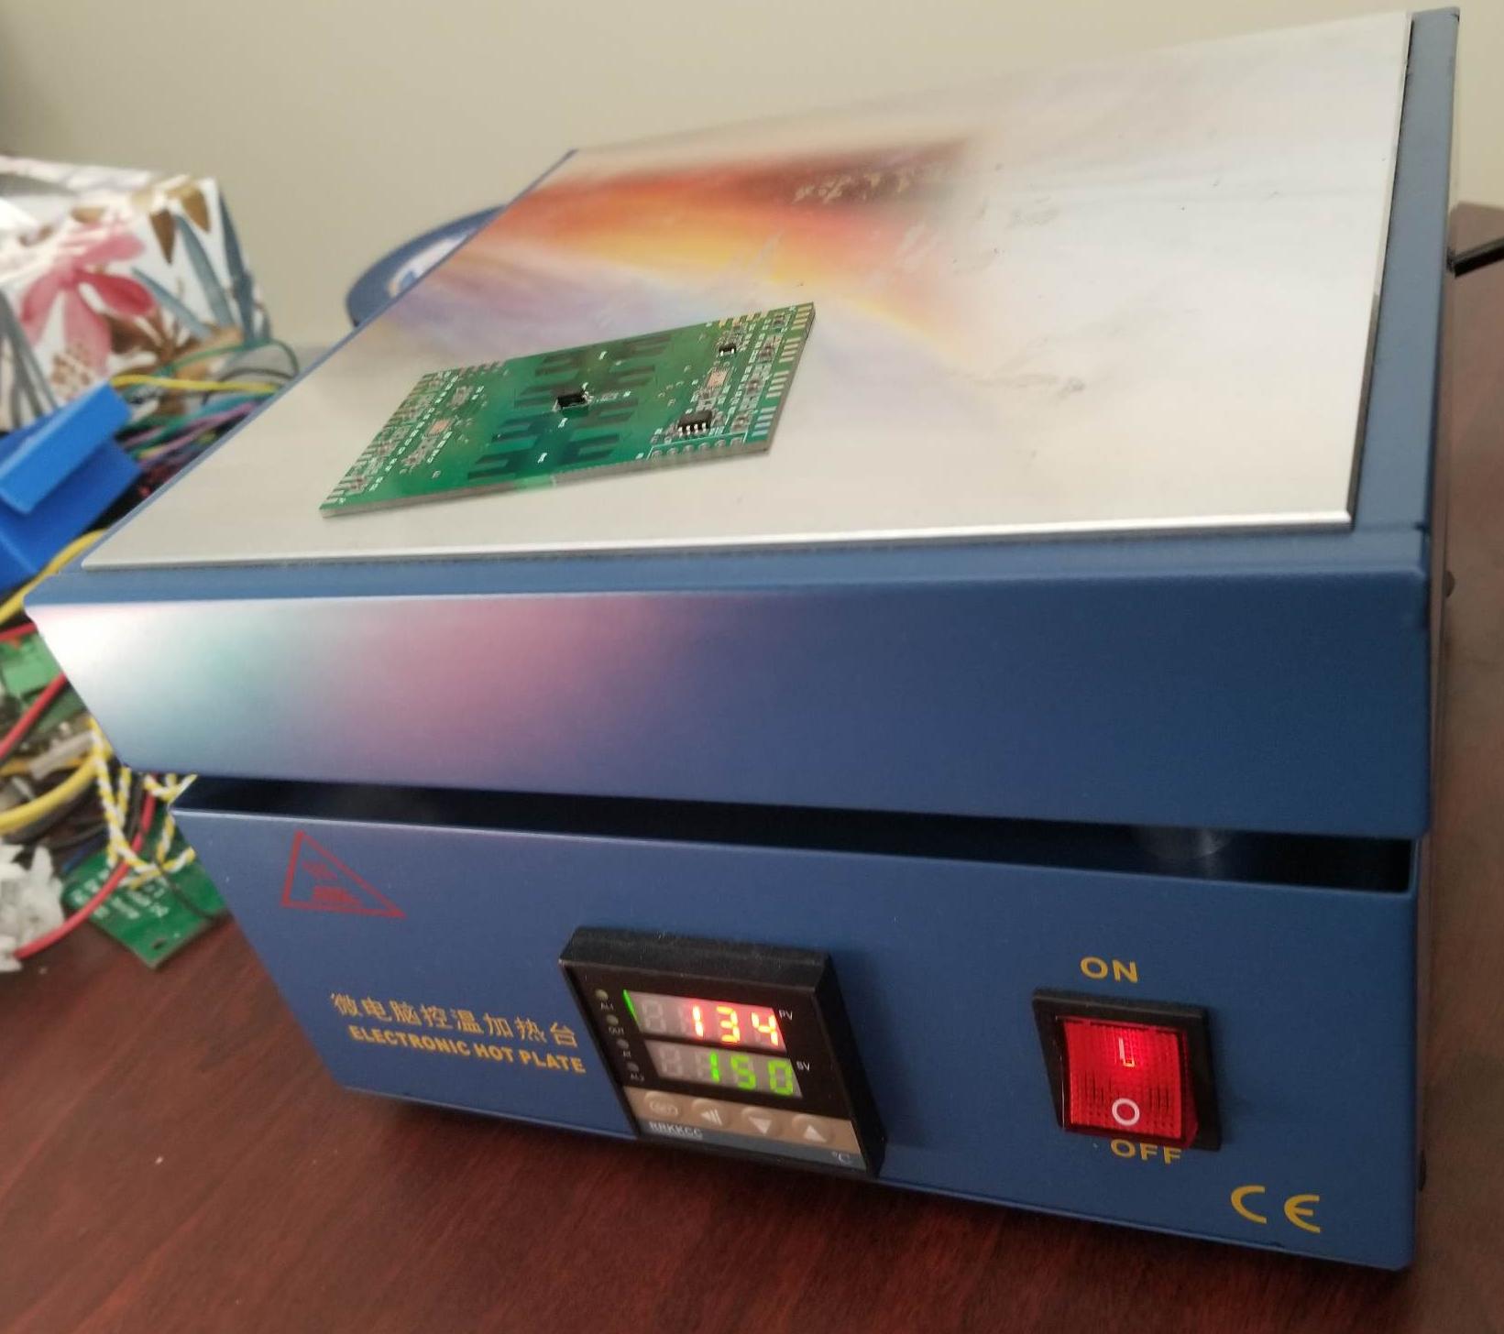
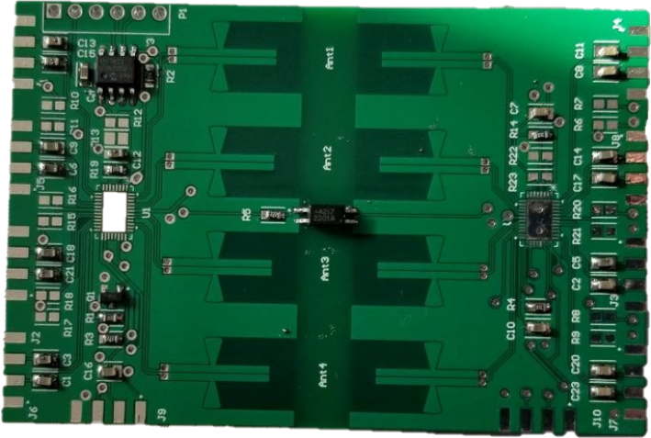
Assembly

Slide 24
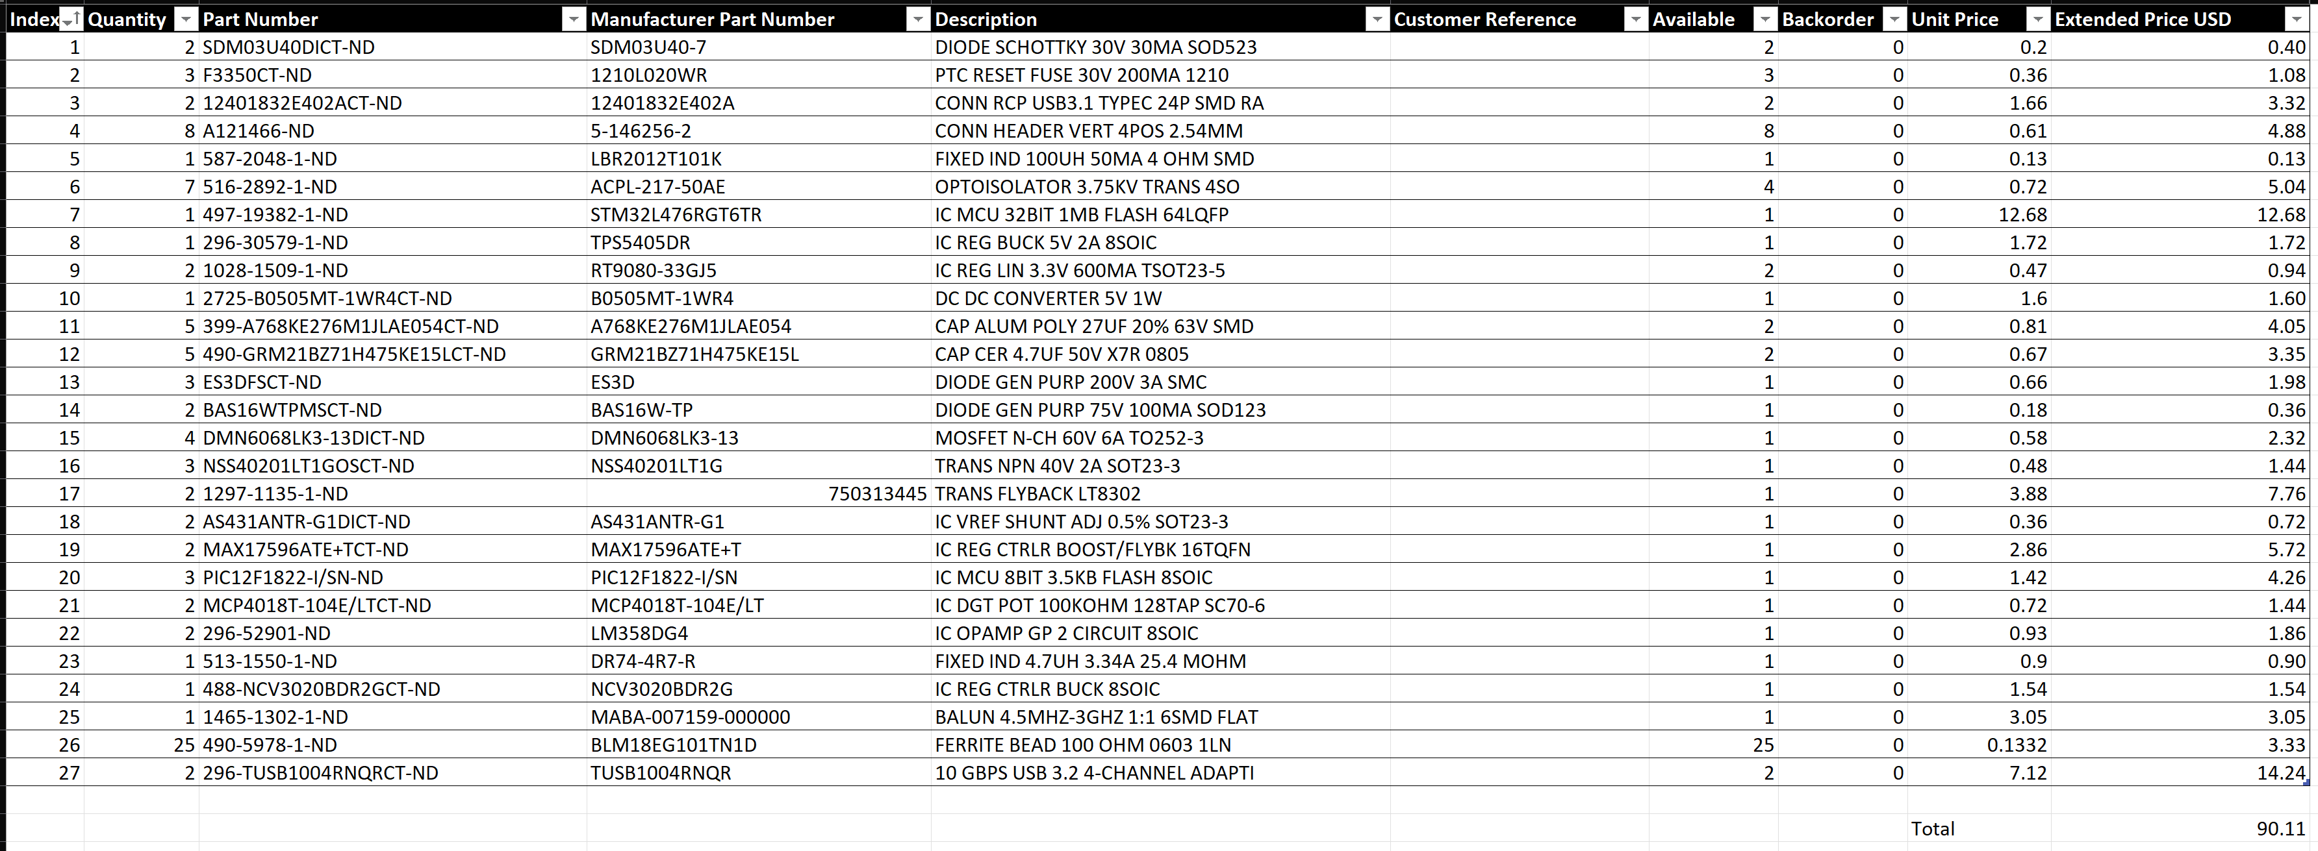
BOM/ Funding
Parts total: $100 (100 ish components)
PCBs total: $400 (50 PCBs total)
Applied for bursary
Received $500 in funding from Eng department instead
Thanks to Eng department/ Engineering Endowment Fund

Slide 25
Improvements that could be made
Power
Efficiency (about 50% currently)
Better thermal design (gets to 90C now)
Increase max power to 100W
Data
Current USB3 design subject to cross talk because of no ground plate
Use stripline antennas instead of microstrip, go to 12 layer board
Traces should be length matched
Do better job at cost engineering
Minor PCB changes needed

Slide 26
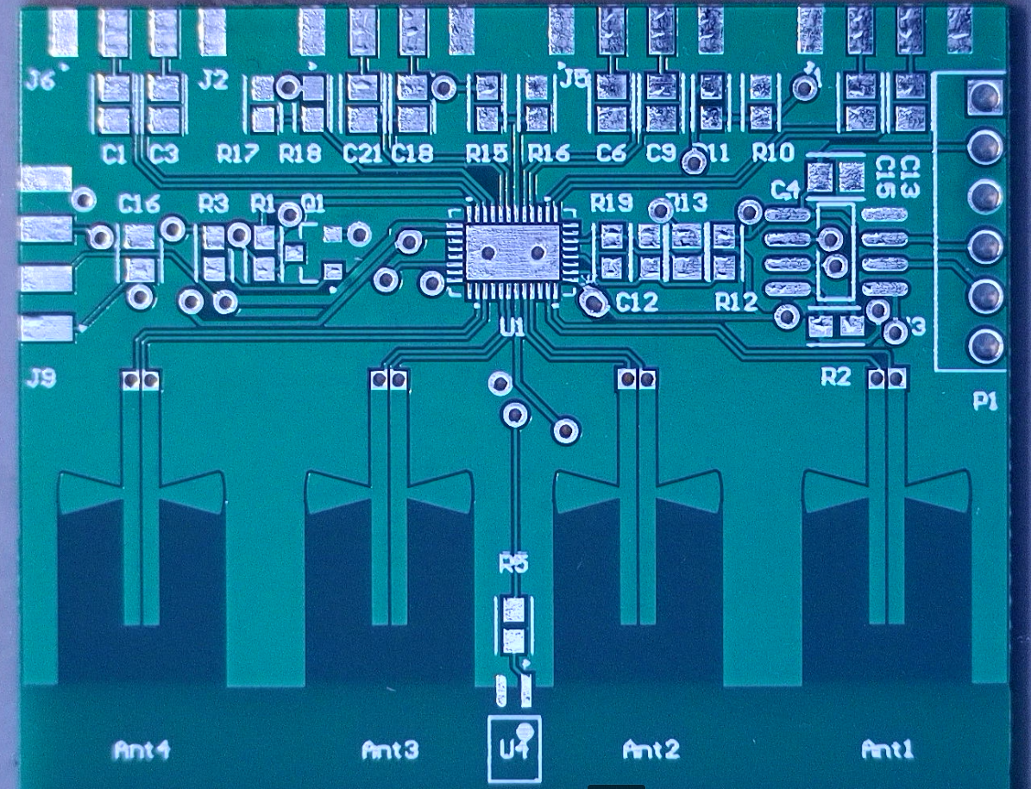
Oversights
Time: PCB review took a long time
Cross talk on USB3 channels
Altium: license can be a pain. Does not work on mac

Slide 27
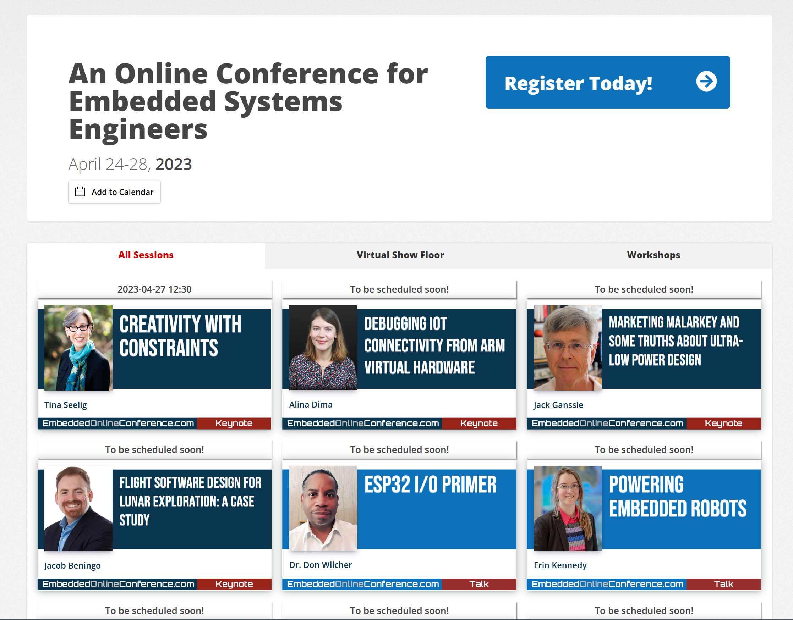
Resources we used
Embedded online conference
https://embeddedonlineconference.com/
April 24th to 28th 2023
Student discount available (~$40 USD)
Chat GPT (used for all firmware)
Altium
Fusion 360 (CAD)
Ultra librarian (for footprints)
AWR (EM simulations)

Slide 28
Discussion and Questions

